Slide 1
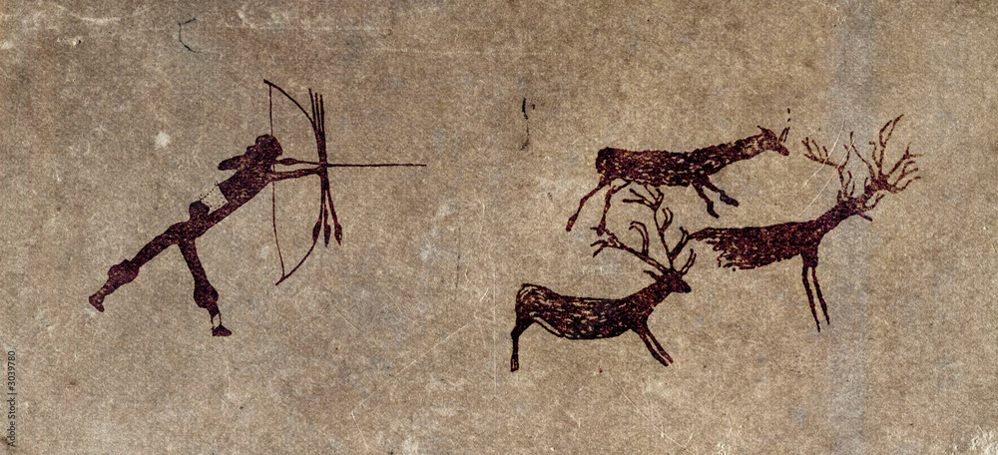
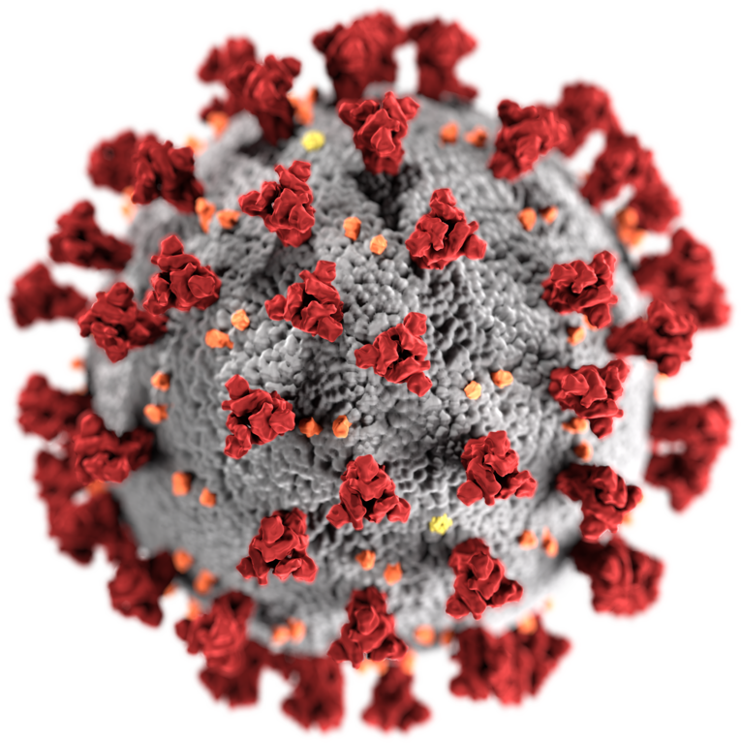
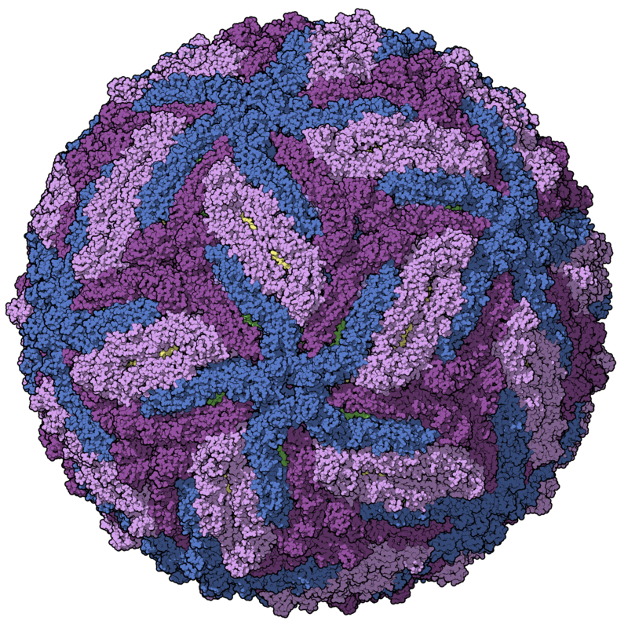
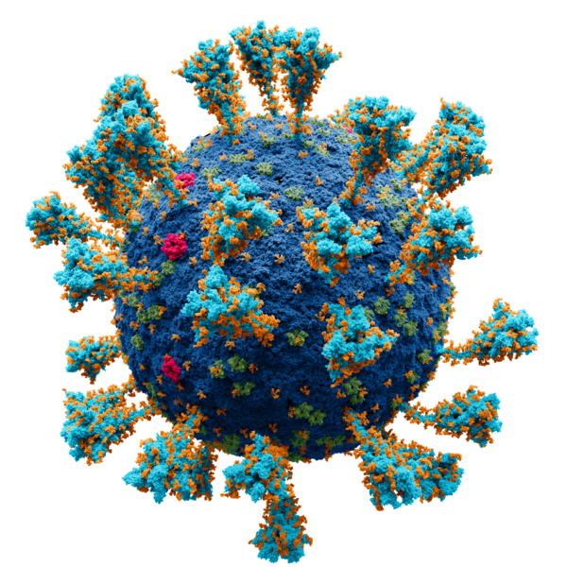
Virome characterisation from unprocessed local and publicly available sequencing data
VirusHunterGatherer and Virusparies
Sergej Ruff
Twincore - RG Computational Virology
29 October 2024
Notes:
Welcome, everyone to the defense.
Today I want to talk about virus discovery.
Why? Because its an interesting topic and because its the field of the master thesis I am presenting today.
I chatacterized the virome in unprocessed samples – both local data and downloaded from the internet, using VirusHunter for discovery and Gathrer for assembly.
I also contributed my own application called Virusparies.
Here I want to go into detail. Lets start.

Slide 2
Characterzation of the virome,VirusHunterGatherer and Virusparies - Outline
Introduction
Background: Importance of virus discovery
History of virus discovery
Summary and goals
Methods and material used
Workflow
Hittables
Virusparies
Data
Results
Taubert
Assembled sequences in mammalian samples
4. Conclusion and outlook
Notes:
Starting with the outline. As you can see it follows the same outline as the master thesis itself.

Slide 3
Introduction
Why do We need virus discovery?
Notes:
I would like to start the introduction by answering the question why we need virus discovery.

Slide 4
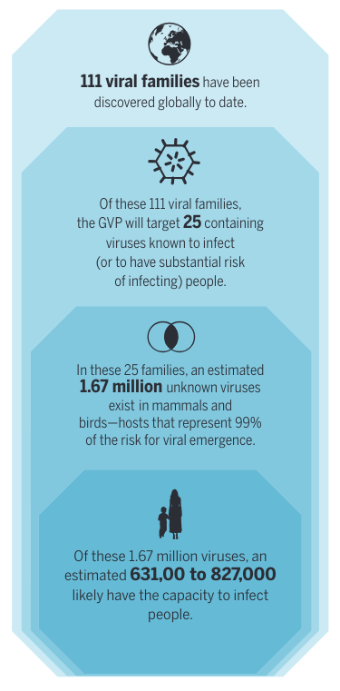
Introduction: Importance of virus discovery
- Pandemics: number of unknown viruses
“Following each outbreak, the public health community be-moans a lack of prescience, but after decades of reacting to each event with little focus on mitigation, we remain only marginally better protected against the next epidemic. Our ability to mitigate disease emergence is undermined by our poor understanding of the diversity and ecology of viral threats, and of the drivers of their emergence.”
Carroll D, Daszak P, Wolfe ND, et al. The Global Virome Project. Science.
2018;359(6378):872-874. doi:10.1126/science.aap7463
Notes:
The first obvious reason: disease, epidemics and pandemic causing viruses.
Estimates of global virome project from 2018.
Looked at 25 virus families in mammals and birds
Estimated number of unknown viruses.
1.67 million unknown viruses, half can infect humans.
Interesting thing the paper point out
Why is that important?

Slide 5
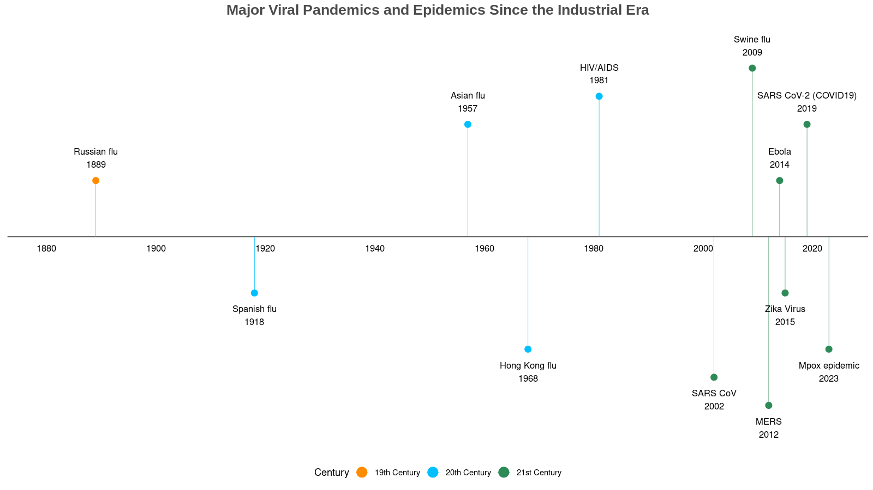
Introduction:
Importance of virus discovery
- Pandemics
“Earlier, large-scale epidemics spanning various continents were a twice or thrice a century phenomenon, but we have experienced 6 major pandemics in the last 20 years itself.”
Bhadoria P, Gupta G, Agarwal A. Viral Pandemics in the Past Two Decades: An Overview. J Family Med Prim Care. 2021 Aug;10(8):2745-2750. doi: 10.4103/jfmpc.jfmpc_2071_20. Epub 2021 Aug 27. PMID: 34660399; PMCID: PMC8483091.
Notes:
Well, if we look at some of the major epidemics and pandemics since the industrialisation.
Increase in epidemics and pandemics in comparison to the last centrury. Same observation was made by Bhadoria et al.
Pandemics used to occure 1-3 times each century, we saw 6 in this century alone release of the paper we saw the Mpox outbreak. Most being zoonoses coming from mammals and birds.
Reasons: globalisation, increased air traffic and more contact with animals.
Need for virus discovery to understand the diversity of the virosphere to combate the next epidemic
Mention that those are major human pandemics and epidemics.
→ Unterschied zwischen pandemic und epidemic naschauen + die Sachen zu den pandemien wissen
→ Paper lesen.

Slide 6
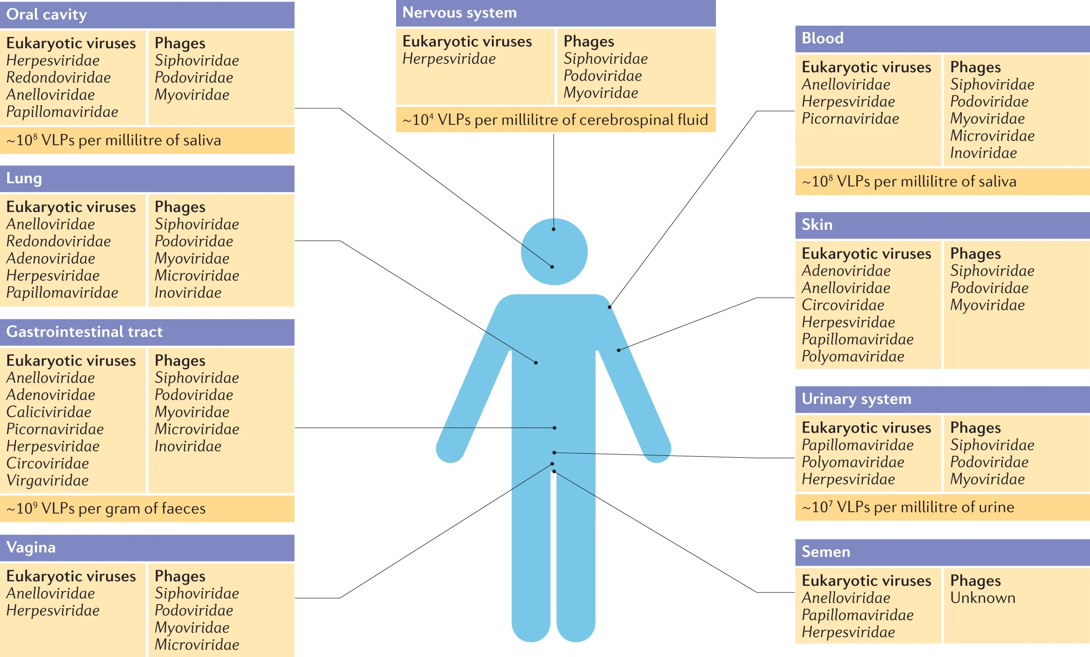
Liang, G., Bushman, F.D. The human virome: assembly, composition and host interactions. Nat Rev Microbiol 19, 514–527 (2021). https://doi.org/10.1038/s41579-021-00536-5
Introduction: Importance of viral discovery - Virome
approximately 10¹³ particles per human individual.
High heterogeneity across different body sites
Infecting our cells and cellular microorganisms.
Human endogenous retroviruses (HERV),Herpesvirus 6, Anelloviridae.
“ Despite increasing focus, it remains the case that the majority of sequence data in a typical virome study remain unidentified, highlighting the extent of unexplored viral ‘dark matter’.”
Notes:
Second reason is the virome.
We all harbor 10¹³ viral particles in us spread with a hight heterogeneity across different body sites.
Some infect our cells, but most infect our microbiota.
Besides the disease causing viruses, there known viruses that contributed positivly to our evolution such as Syncytin retroviral protein contributing to the placenta development. Anneloviridae commensal.
Diversity and complex interactions of the virome are still largely unknown.
Erwähnen, dass es positive, negative und Kommensale gibt
→ Paper lesen.

Slide 7


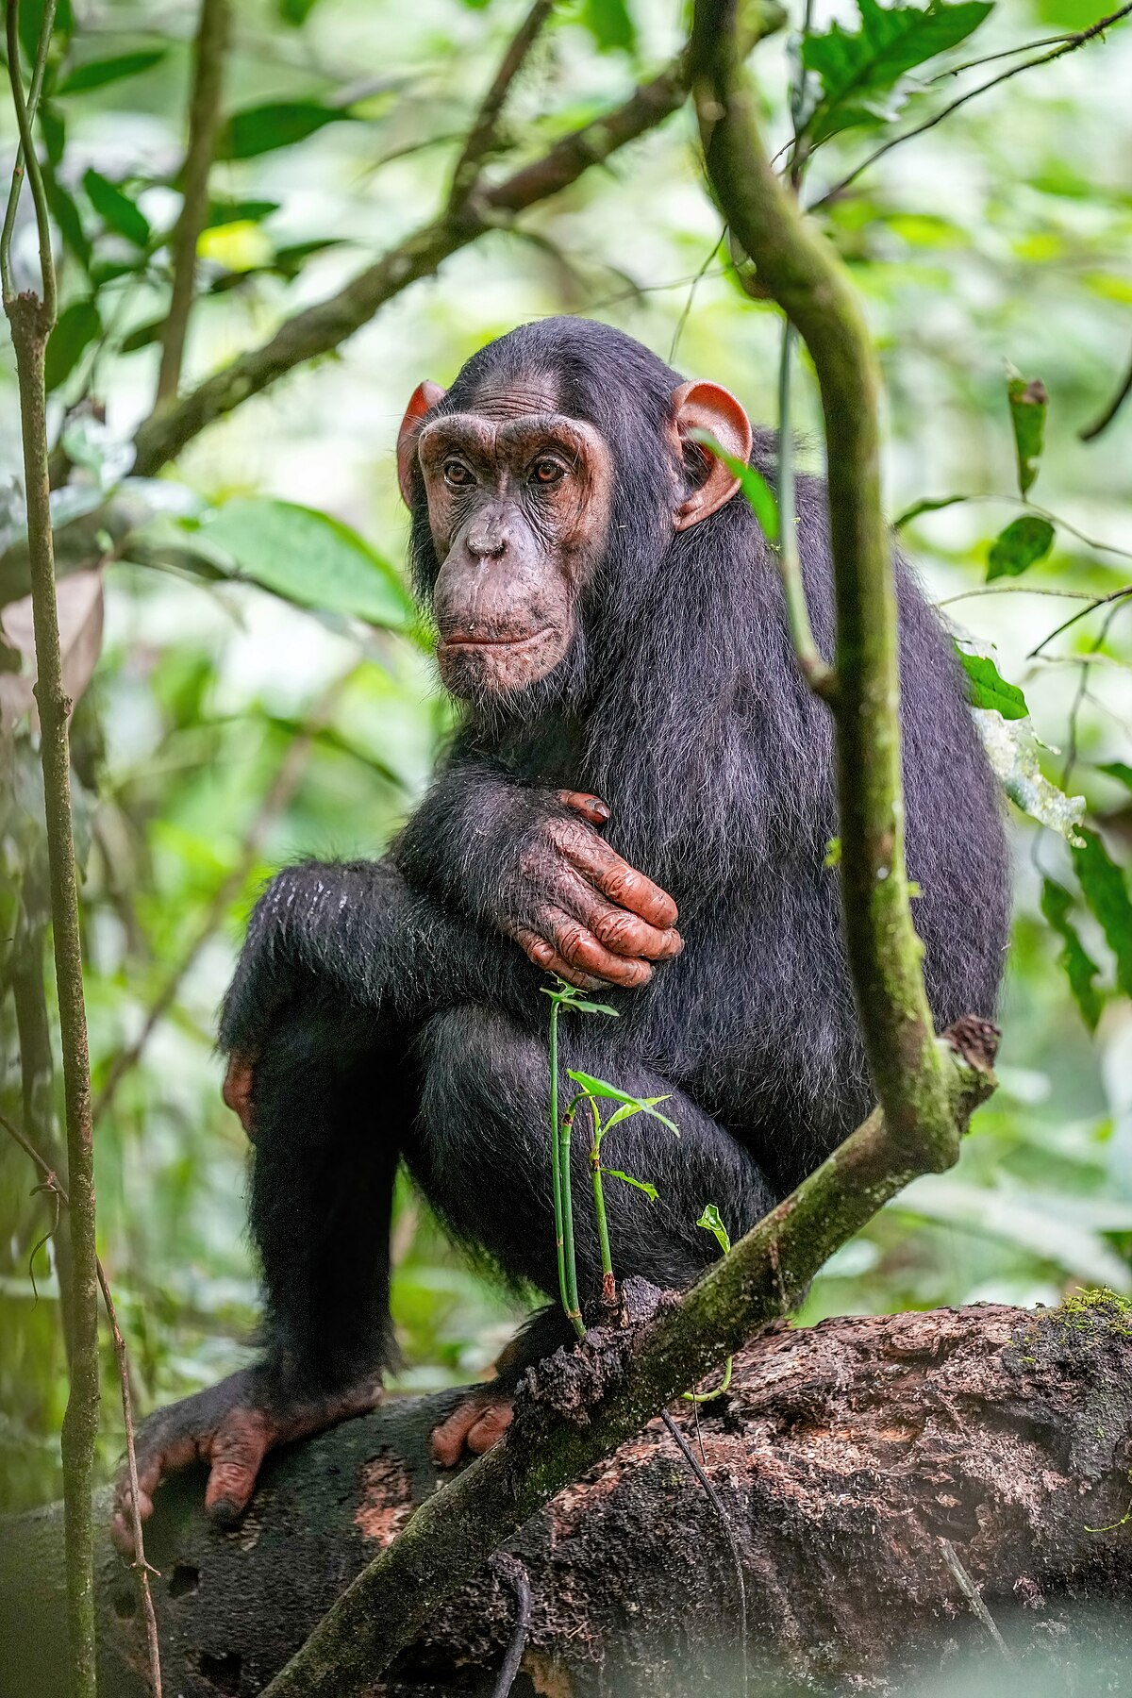
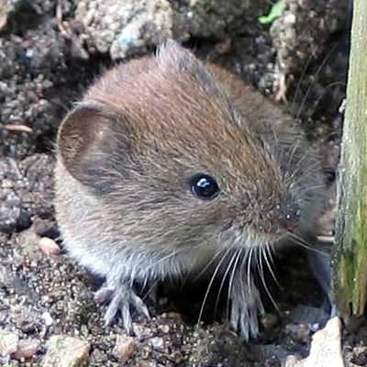
Introduction: Importance of virus discovery – surrogate viruses and viral history
GBV-B
current surrogate for HCV.
Limitations:
reduced efficiency, rarely causes chronic infection.
Tamarin breeding: costly, ethical concerns.
ssRNA(+) virus
Genus: Hepacivirus
Family: Flaviridae
Phylum: Kitrinoviricota
Surrogate
Virus discovery
insights into evolution
links to (human) diseases.
surrogate viruses
Pre-2011: hepaciviruses only known in humans and chimpanzees.
Now: new mammalian and non-mammalian hepaciviruses discovered.
Endangered!
Approximately 50 million people are living with HCV infection (Global hepatitis report 2024: action for access in low- and middle-incomecountries).
Liver fibrosis: abnormal buildup of extracellular matrix proteins in the liver, often leading to liver failure and cirrhosis. Hepatocellular carcinoma (HCC) → liver cancer.
Treatment: direct-acting antiviral (DAAs) regimens.
George-
Baker virus
B (GBV-B)
?
Notes:
For the third point
GBV-B is a known virus related to HCV
Value of virus discovery would be if we find a new yet unidentified virus related to HCV, which infects a mammel, that is easy to maintain and use in lab, and that can cause the typical symptoms of HCV infection.
New slide
Virus evolution – Find possible associations to human diseases – surrogate viruses

Slide 8
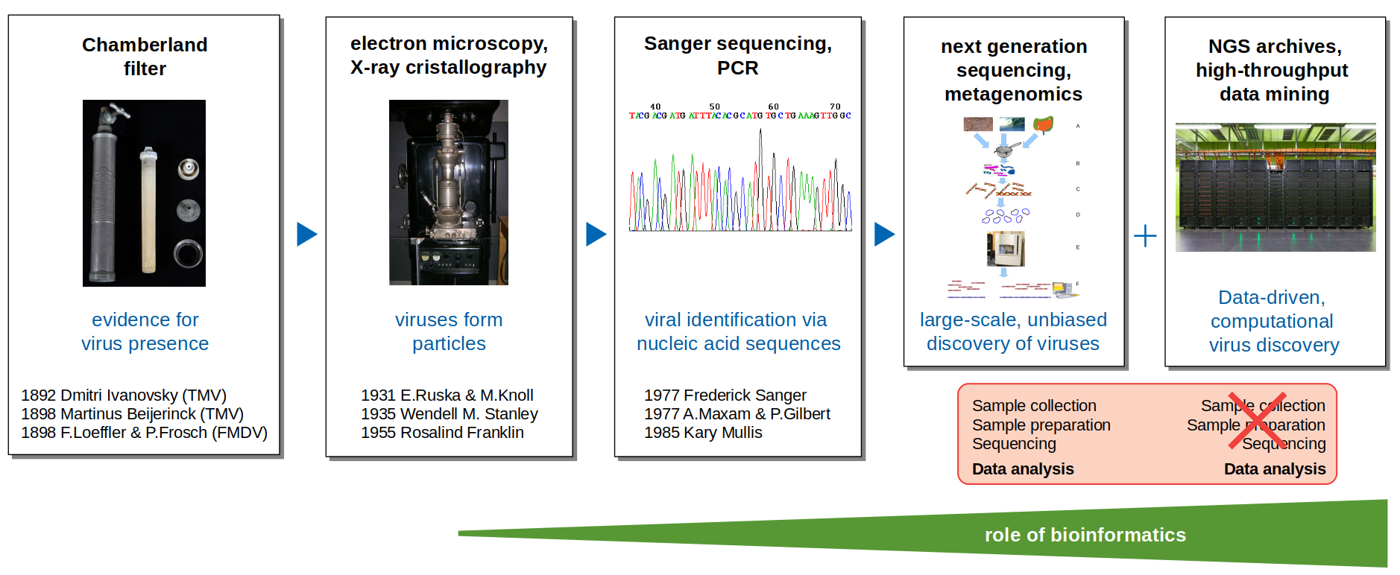
Introduction: History of virus discovery
Image taken from Prof. Dr. Chris Lauber.

Slide 9
Introduction: Summary and goals
Importance of viral discovery
Identification of (Novel) Viruses During Outbreaks.
Better Understanding of the Virome.
Exploring Novel Model Organisms for Studying Human Viral Infections.
New data-driven viral discovery is complementary to wet lab experiments, utilizing publicly available data.

Slide 10
Introduction: Goals
Goals:
Utilize VirusHunterGatherer on the liver sequencing data (Taubert) to characterize the virome and assess whether these identified viruses are associated with transplant rejection.
Assemble potential viral sequences found in mammalian samples.
Virusparies:
Subset and process VirusHunter and VirusGatherer output.
Calculate summary statistics.
Create plots and graphical tables for VirusHunter and VirusGatherer data.

Slide 11
Methods and material used

Slide 12
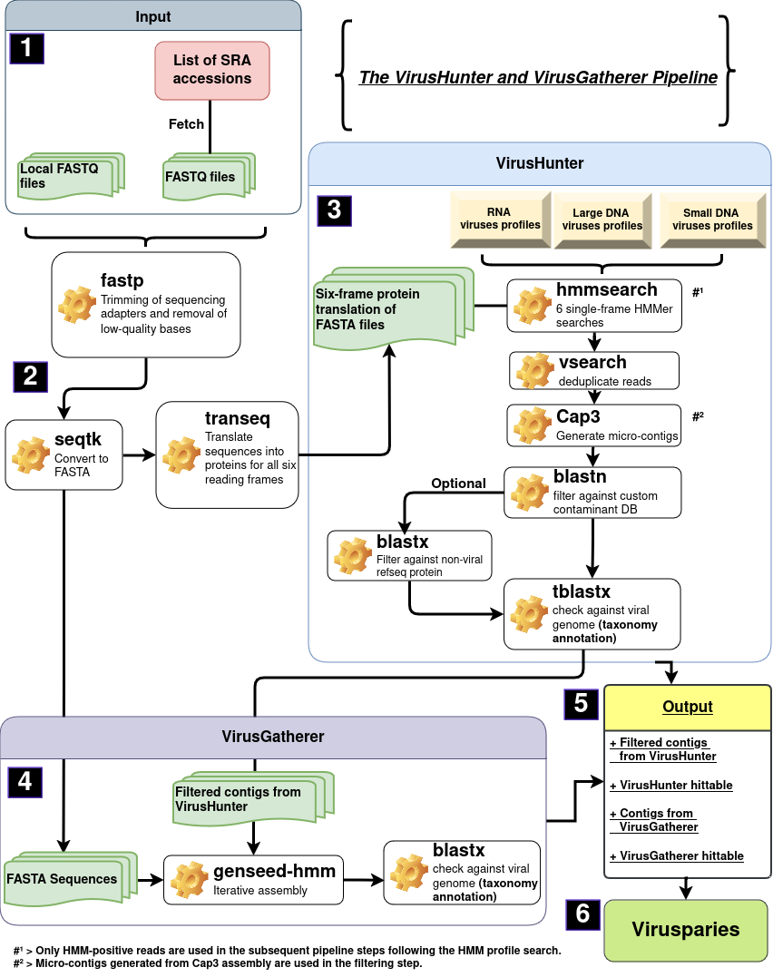



Schematic workflow of
VirusHunterGatherer pipeline
Taubert liver sequencing data
Mammalian sequencing data
SRA

Slide 13
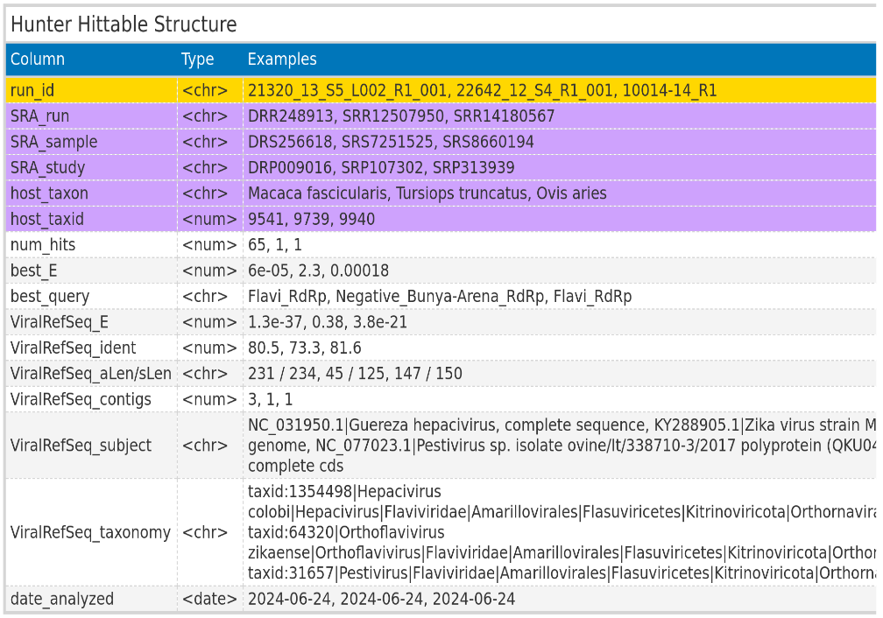
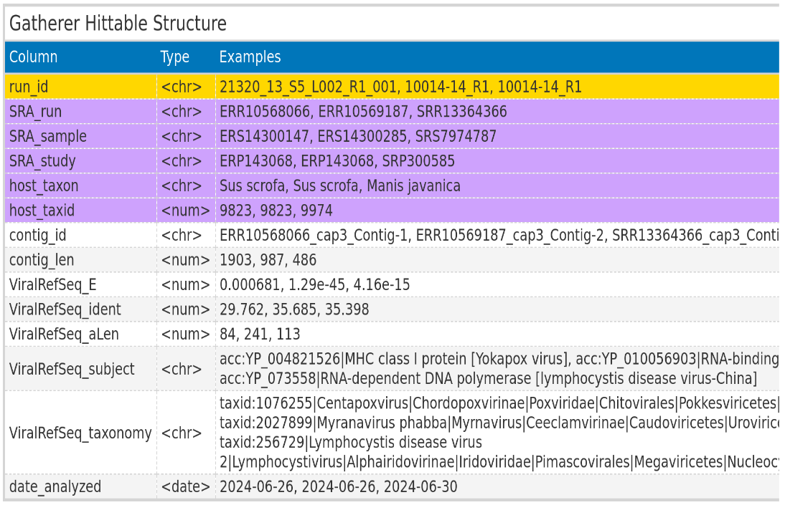
VirusHunterGatherer hittables
ViralRefSeq_taxonomy processed to extract virus family

Slide 14

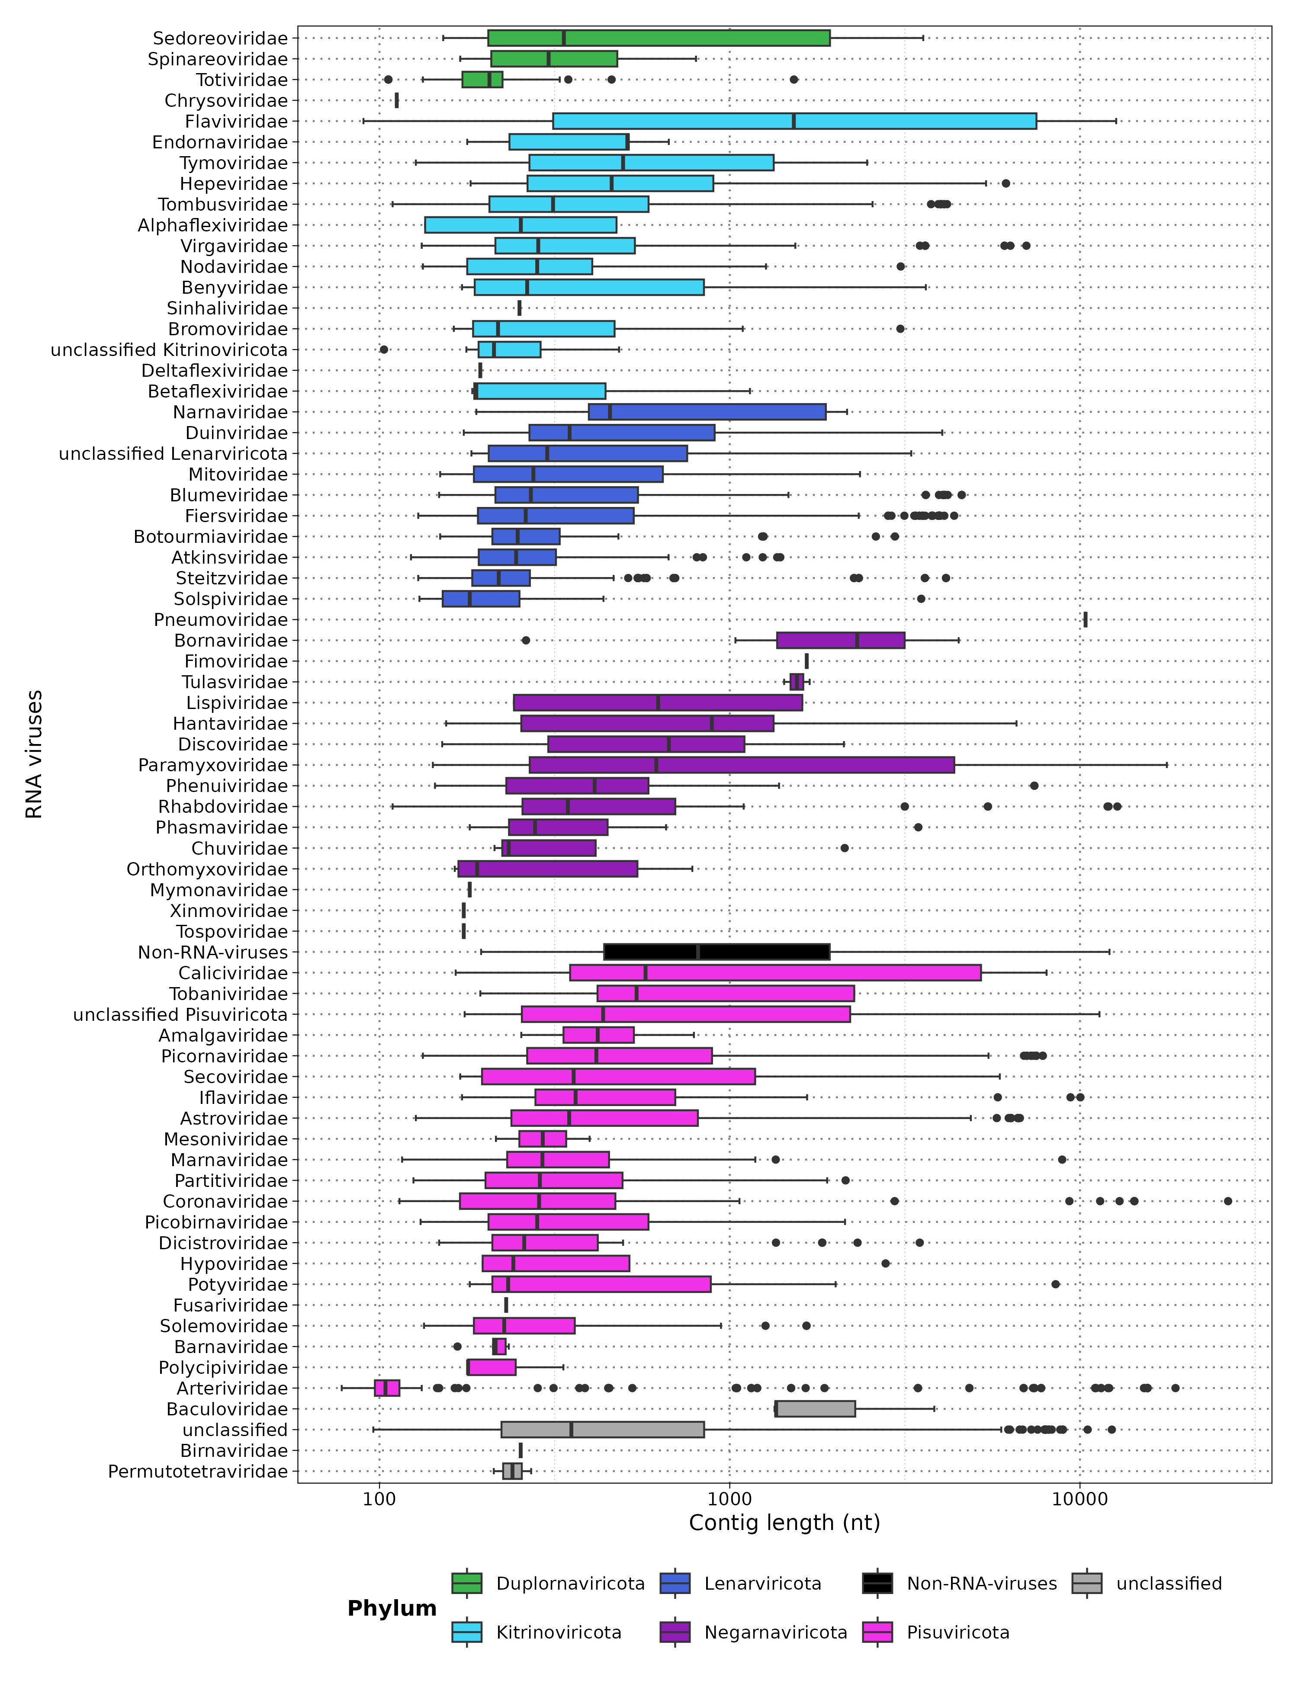
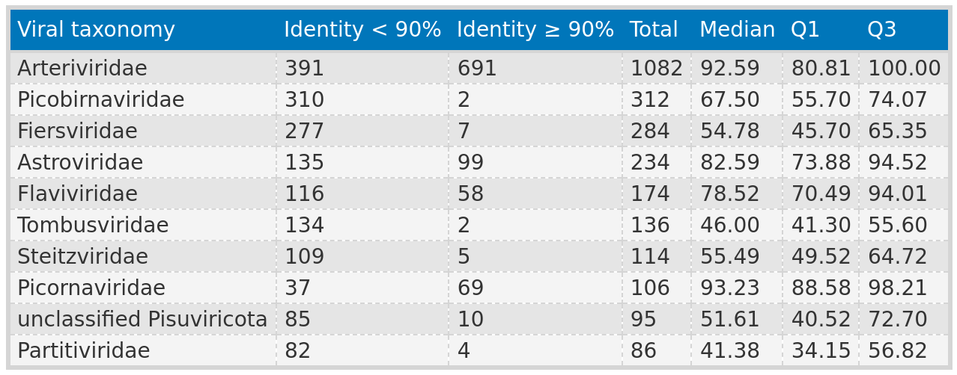
Import/Export
Results: Virusparies
Processing
Summary Statistics
Reports:
Reproducible
Shareable
Highly modular
Accessible to a broader audience

Slide 15
Taubert data
Taubert – Department of Gastroenterology,Hepatology, Infectious Diseases and Endocrinology.
Local files from Taubert.
Samples: RNA sequencing data from liver transplant patient samples.
All Virus groups.
Notes:
Make sure to mention that
Those are liver transplant patients.
RNA
Some rejected the liver
Liver rejection can be grouped into those that antibody rejectenion, t cell rejection or no rejection
Taubert AG already suggested possible reasons why livers were rejected indepenent of viruses and the task here was to check if viruses could be also involved. Our data sugggests their no link to viruses.
I got sequencing data from the liver

Slide 16
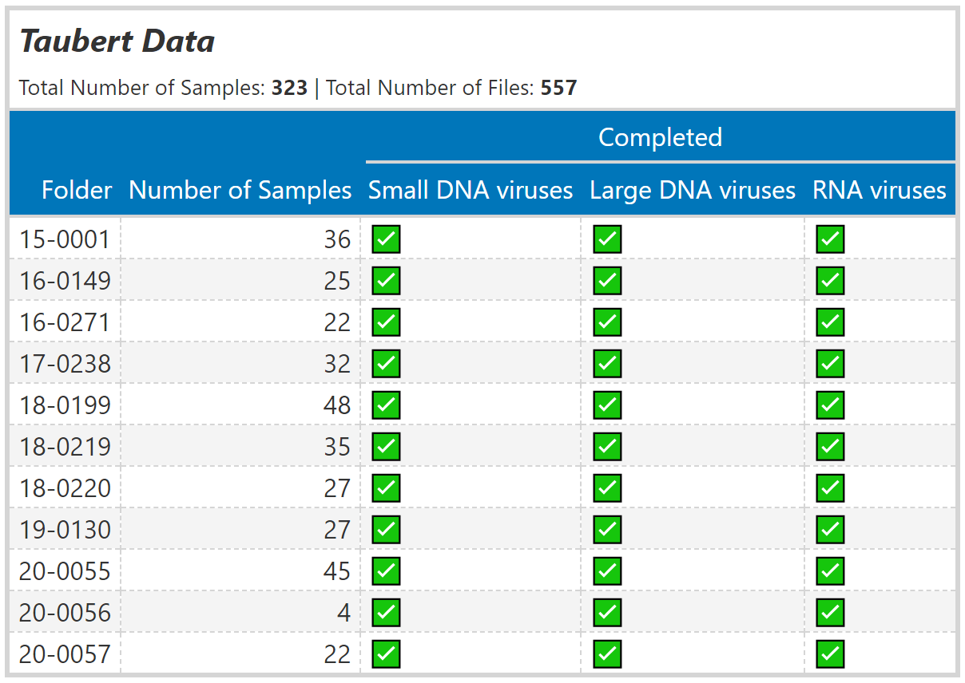
Taubert data – liver sequencing data
Liver samples categorized into groups
No rejection.
T-cell mediated rejection.
Antibody-mediated rejection.
Taubert proposed reasons for liver rejection independent of viruses.
Goal:
Analysis aimed to explore the potential involvement of viruses.

Slide 17
Mammalian data
SRA IDs re-examined from existing hittable.
RNA viruses only.

Slide 18
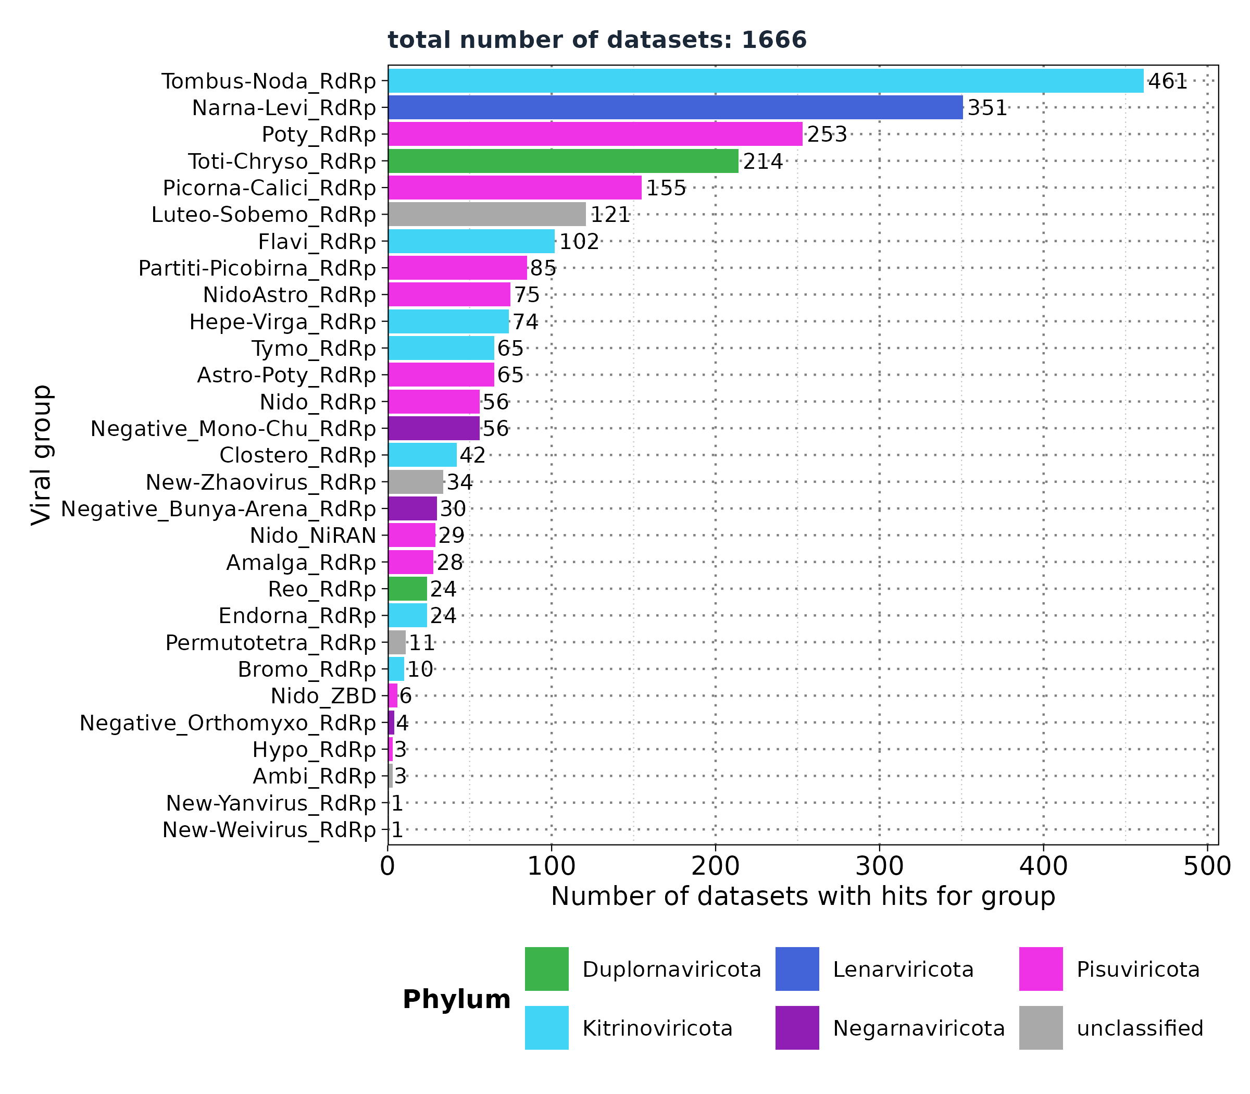
VirusHunter - Screening for RNA viruses in mammalian SRA data
Selected profiles:
Flavi_RdRp
Hepe-Virga_RdRp
Nido_RdRp
Negative_Bunya-Arena_RdRp
Negative_Mono-Chu_RdRp
Negative_Orthomyxo_RdRp
Nido_NiRAN
NidoAstro_RdRp
Existing Hittable:
34.337 unique SRA Ids
Filtered based on:
'num_hits' > 4
'ViralRefSeq_E' < 1e-5
'ViralRefSeq_ident' < 90
Goal:
Assembly of viral contigs.

Slide 19
Results: Taubert

Slide 20
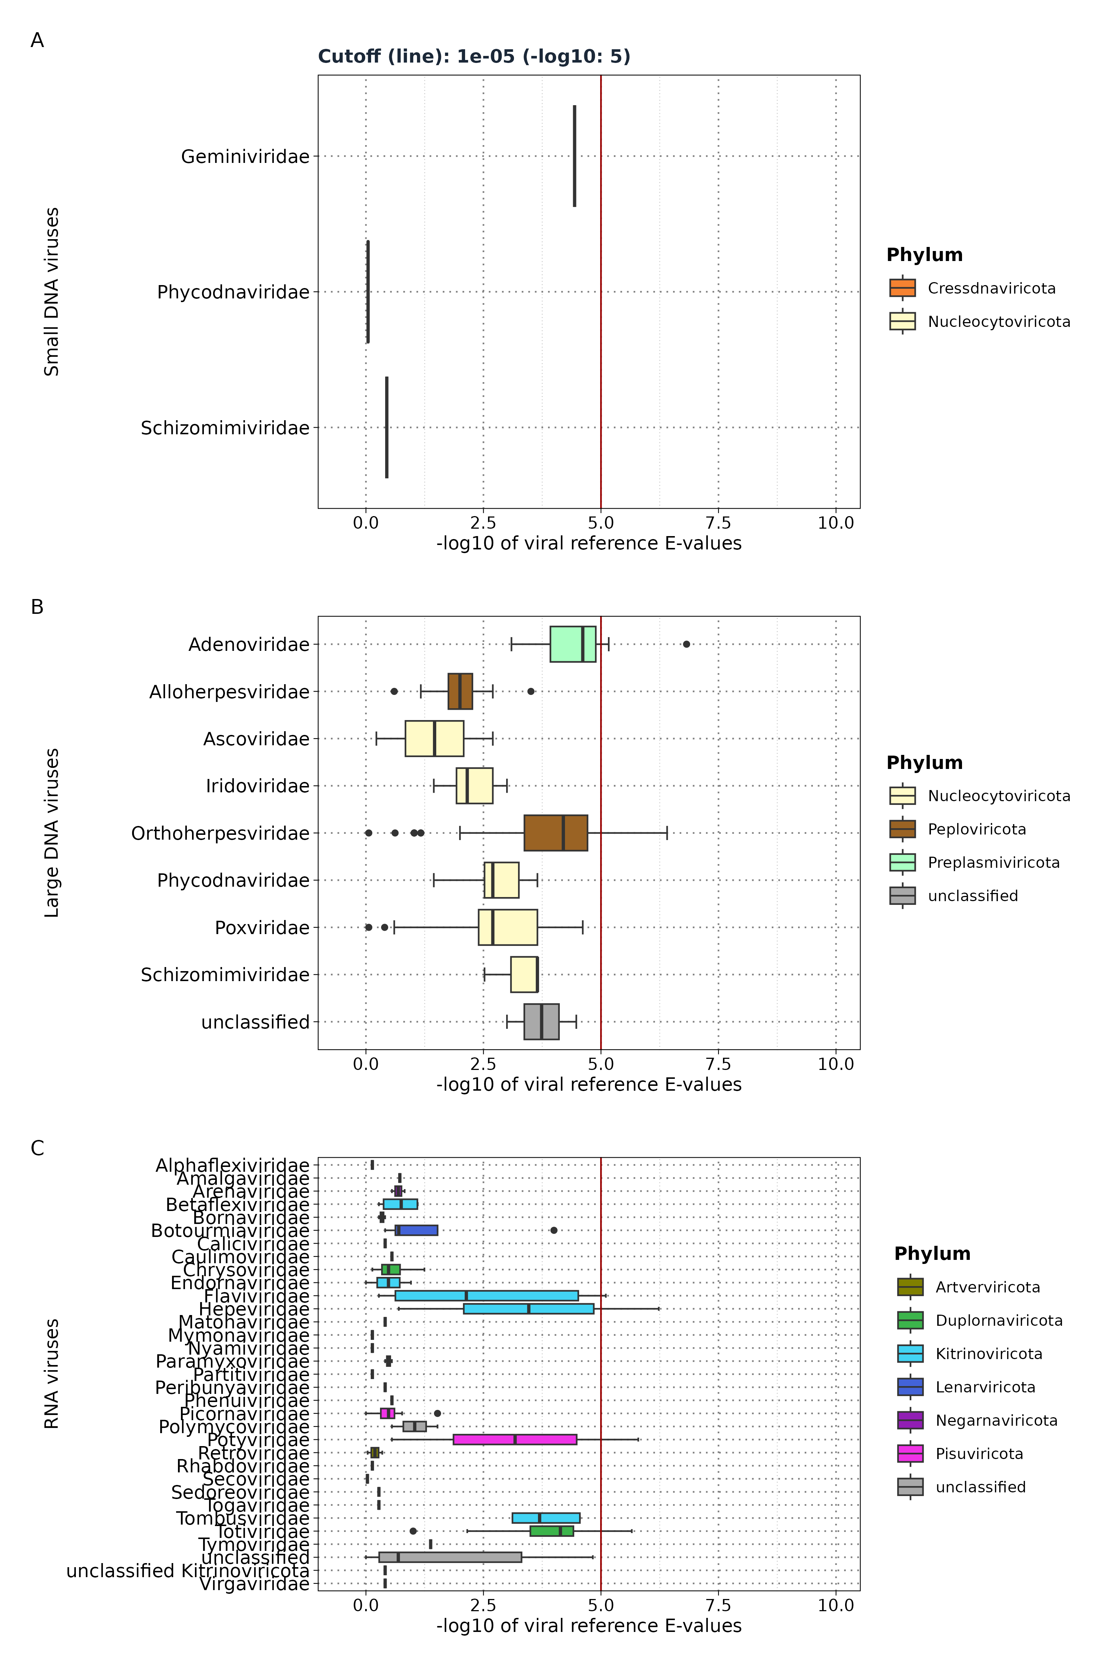
Results: Taubert - Distribution of viral reference
E-values
Liver sequencing data: 557 FASTQ files
VirusHunter
ViralRefSeq_E < 1e⁻⁵
Screening for ...
Small DNA Viruses
Files: 5 (0.89%)
Samples: 4
Families: 3 (0)
Large DNA Viruses
Files: 165 (29.62%)
Samples: 142
Families: 8 (2)
RNA Viruses
Files: 17 (3.05%)
Samples: 13
Families: 31 (4)

Slide 21
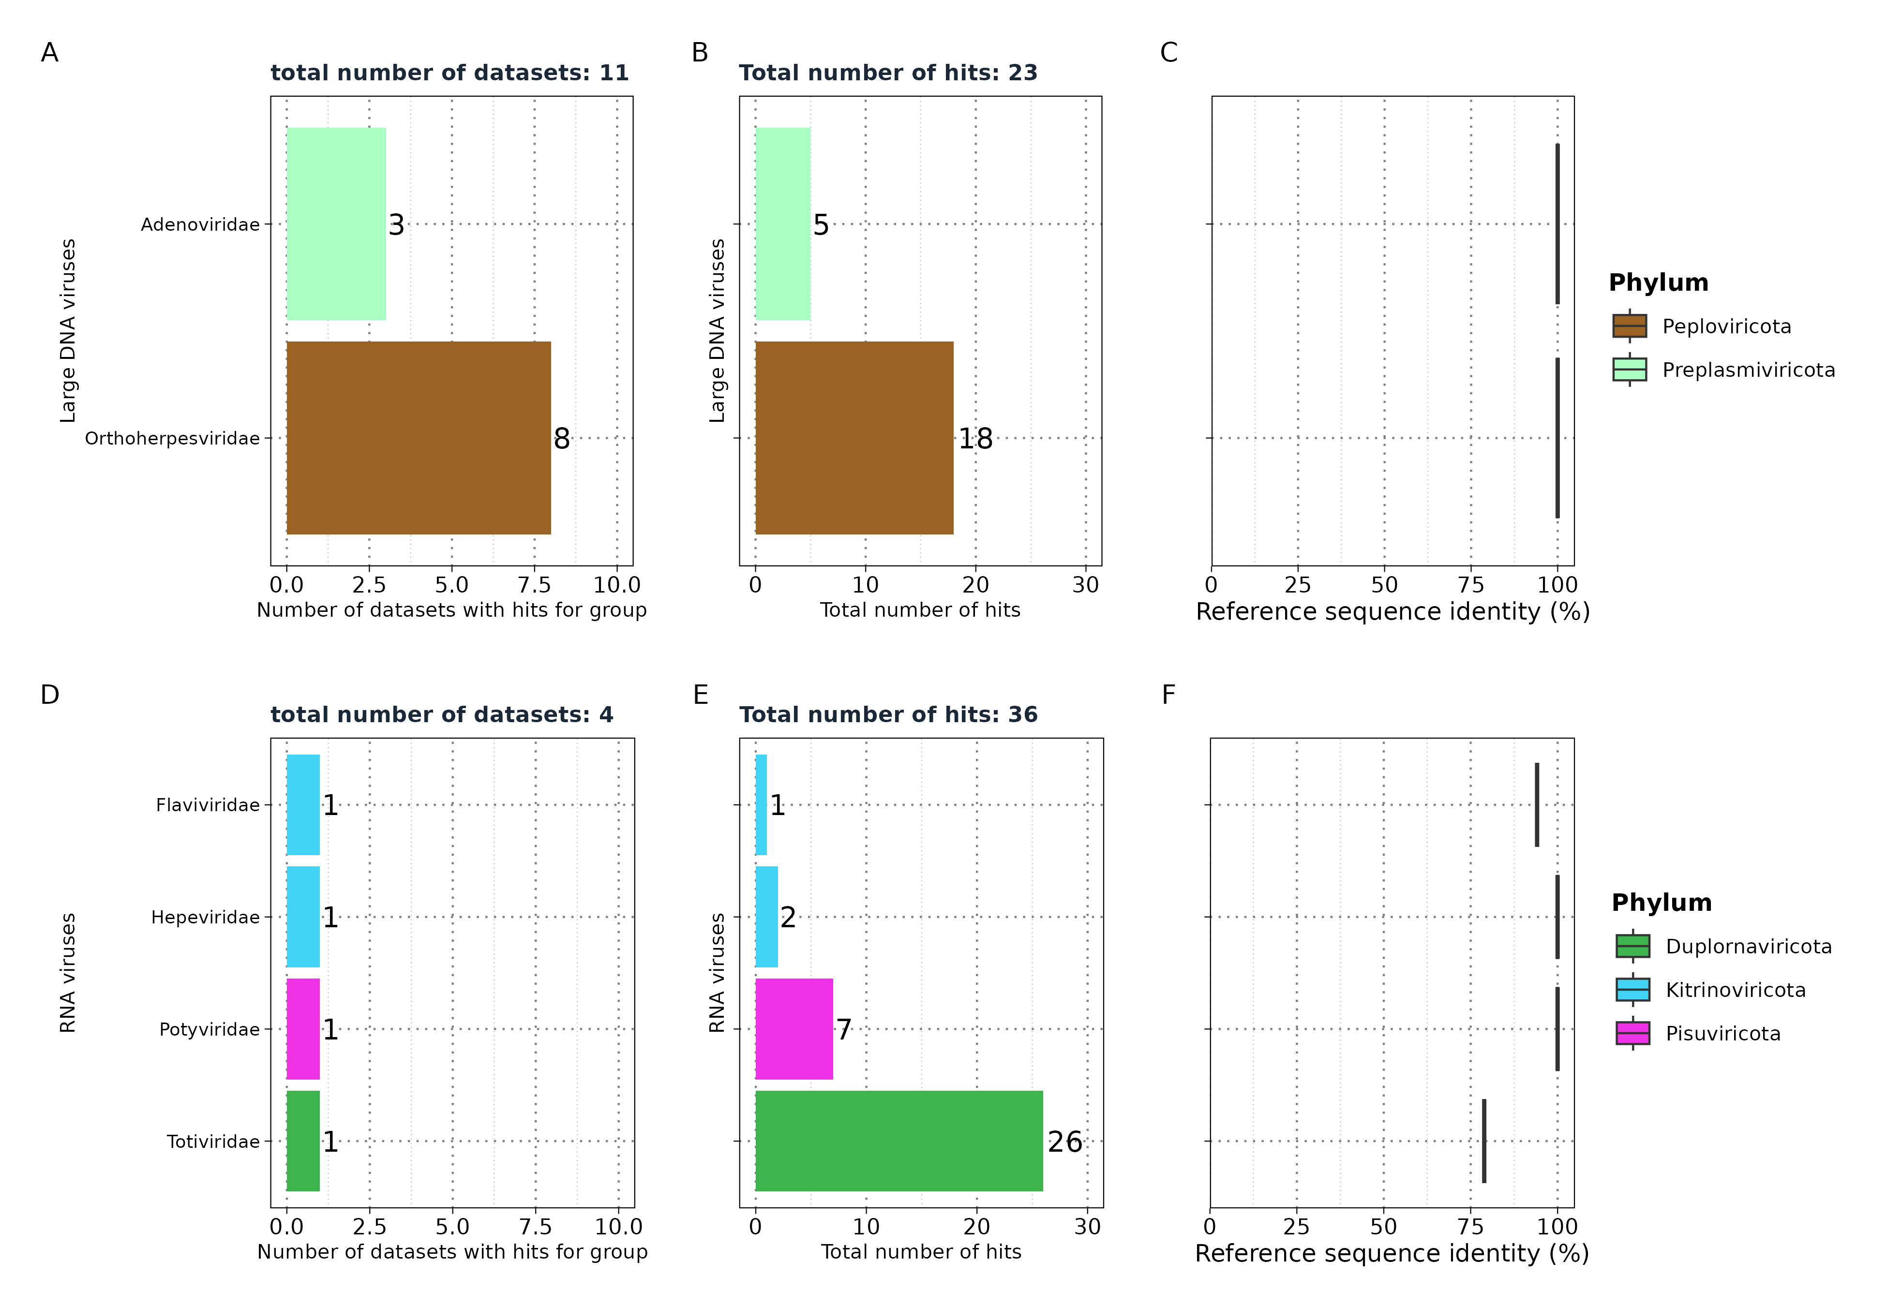
Results: Taubert
significant hits in
VirusHunter

Slide 22
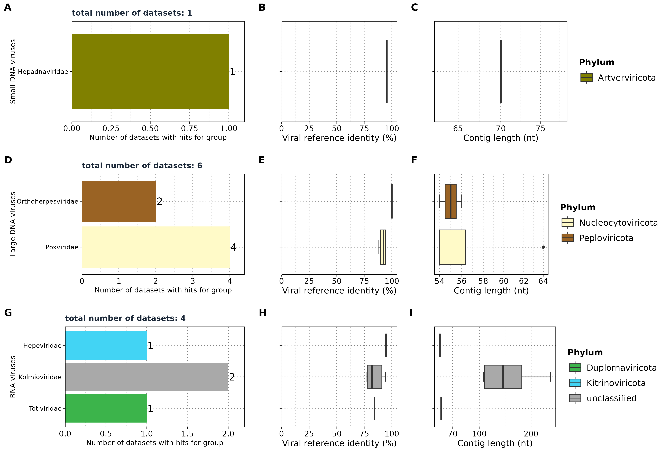
Results: Taubert
VirusGatherer
Liver sequencing data: 557 FASTQ files
VirusHunter
VirusGatherer

Slide 23
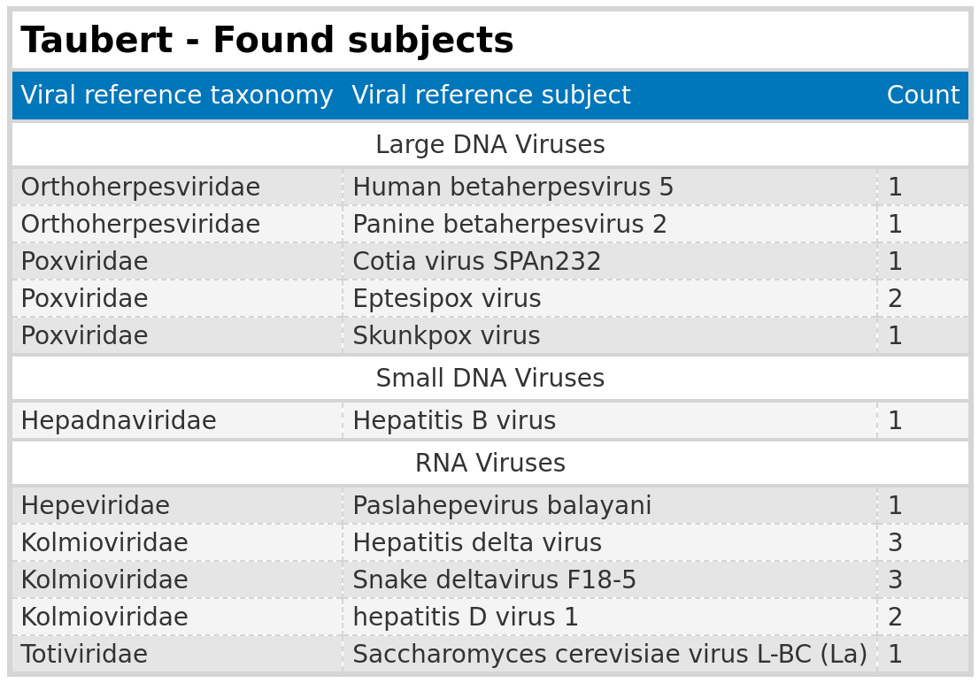
Results: Taubert
subjects

Slide 24
Results: Taubert
Summary
Analysis summary: Completed analysis of Taubert data for small DNA, large DNA, and RNA viruses.
Data overview: Out of 557 FASTQ files, only a maximum of 6 files returned assembled contigs.
Significance threshold: Significant results were close to the E-value cutoff of 1e-5.
Contig lengths: Identified contigs were all below 300 nt.
No conclusive evidence links viral infections to liver rejection.
Notes:
There is no conclusive evidence
Findings suggest that their no evidence for involvement of viruses in the rejection of liver

Slide 25
Results: Mammalian data
Notes:
Next the results for the mammalian data

Slide 26
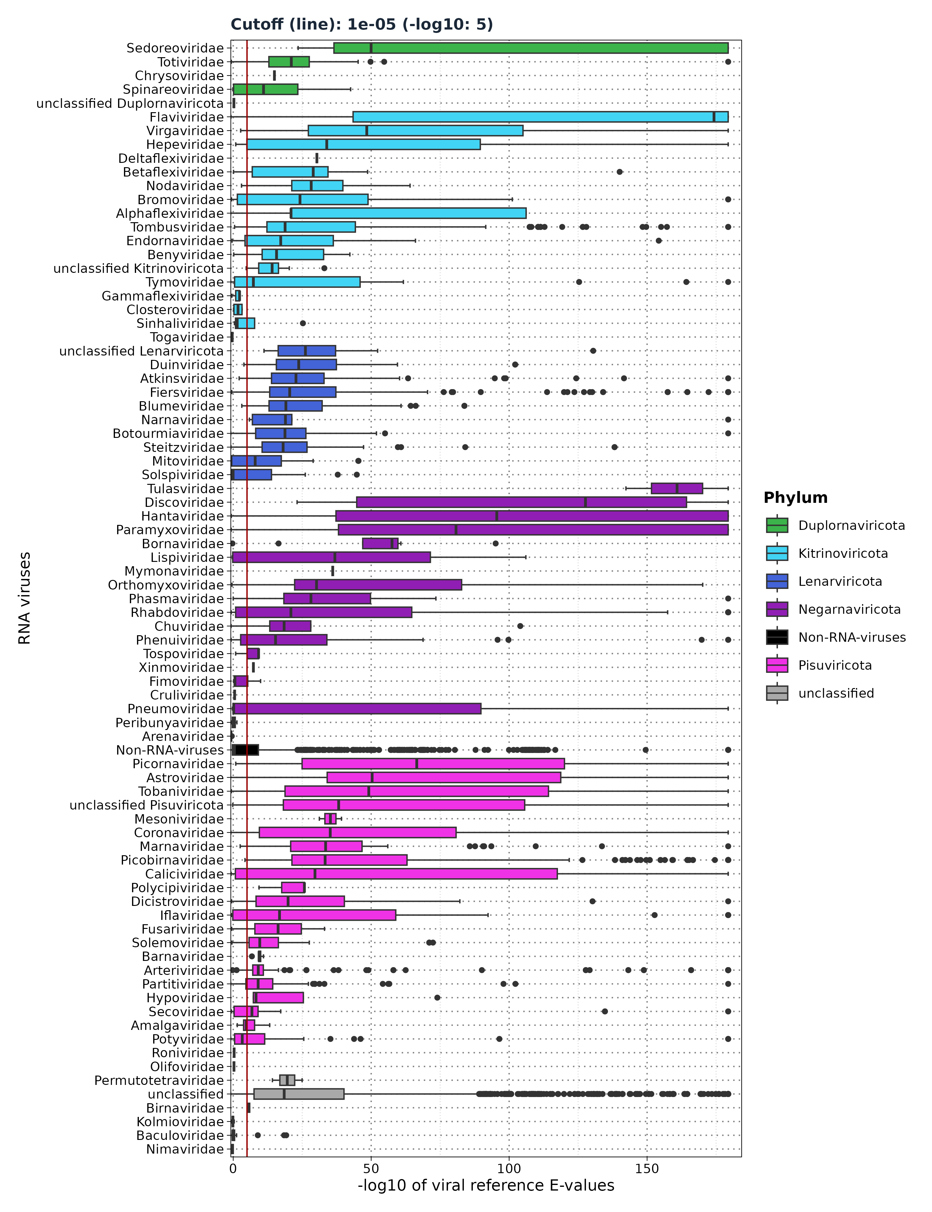
Results: Mammalian – Distribution of viral
reference E-values
VirusHunter
19,113 micro-contigs
VirusGatherer
ViralRefSeq_E < 1e⁻⁵
Assembly returned ...
Total Contigs Assembled: 8,232
Aligned to Viral Families: 128 families + 6 unclassified
High-confidence Alignments: 6,209 contigs with E-values < 1e⁻⁵
Contigs by Phylum
Pisuviricota: 2,553 contigs (2,212 aligned; 86.64%)
Lenarviricota: 773 contigs (686 aligned; 88.75%)
Kitrinoviricota: 552 contigs (453 aligned; 86.78%)
Negarnaviricota: 281 contigs (209 aligned; 74.37%)
Duplornaviricota: 124 contigs (115 aligned; 92.74%)

Slide 27
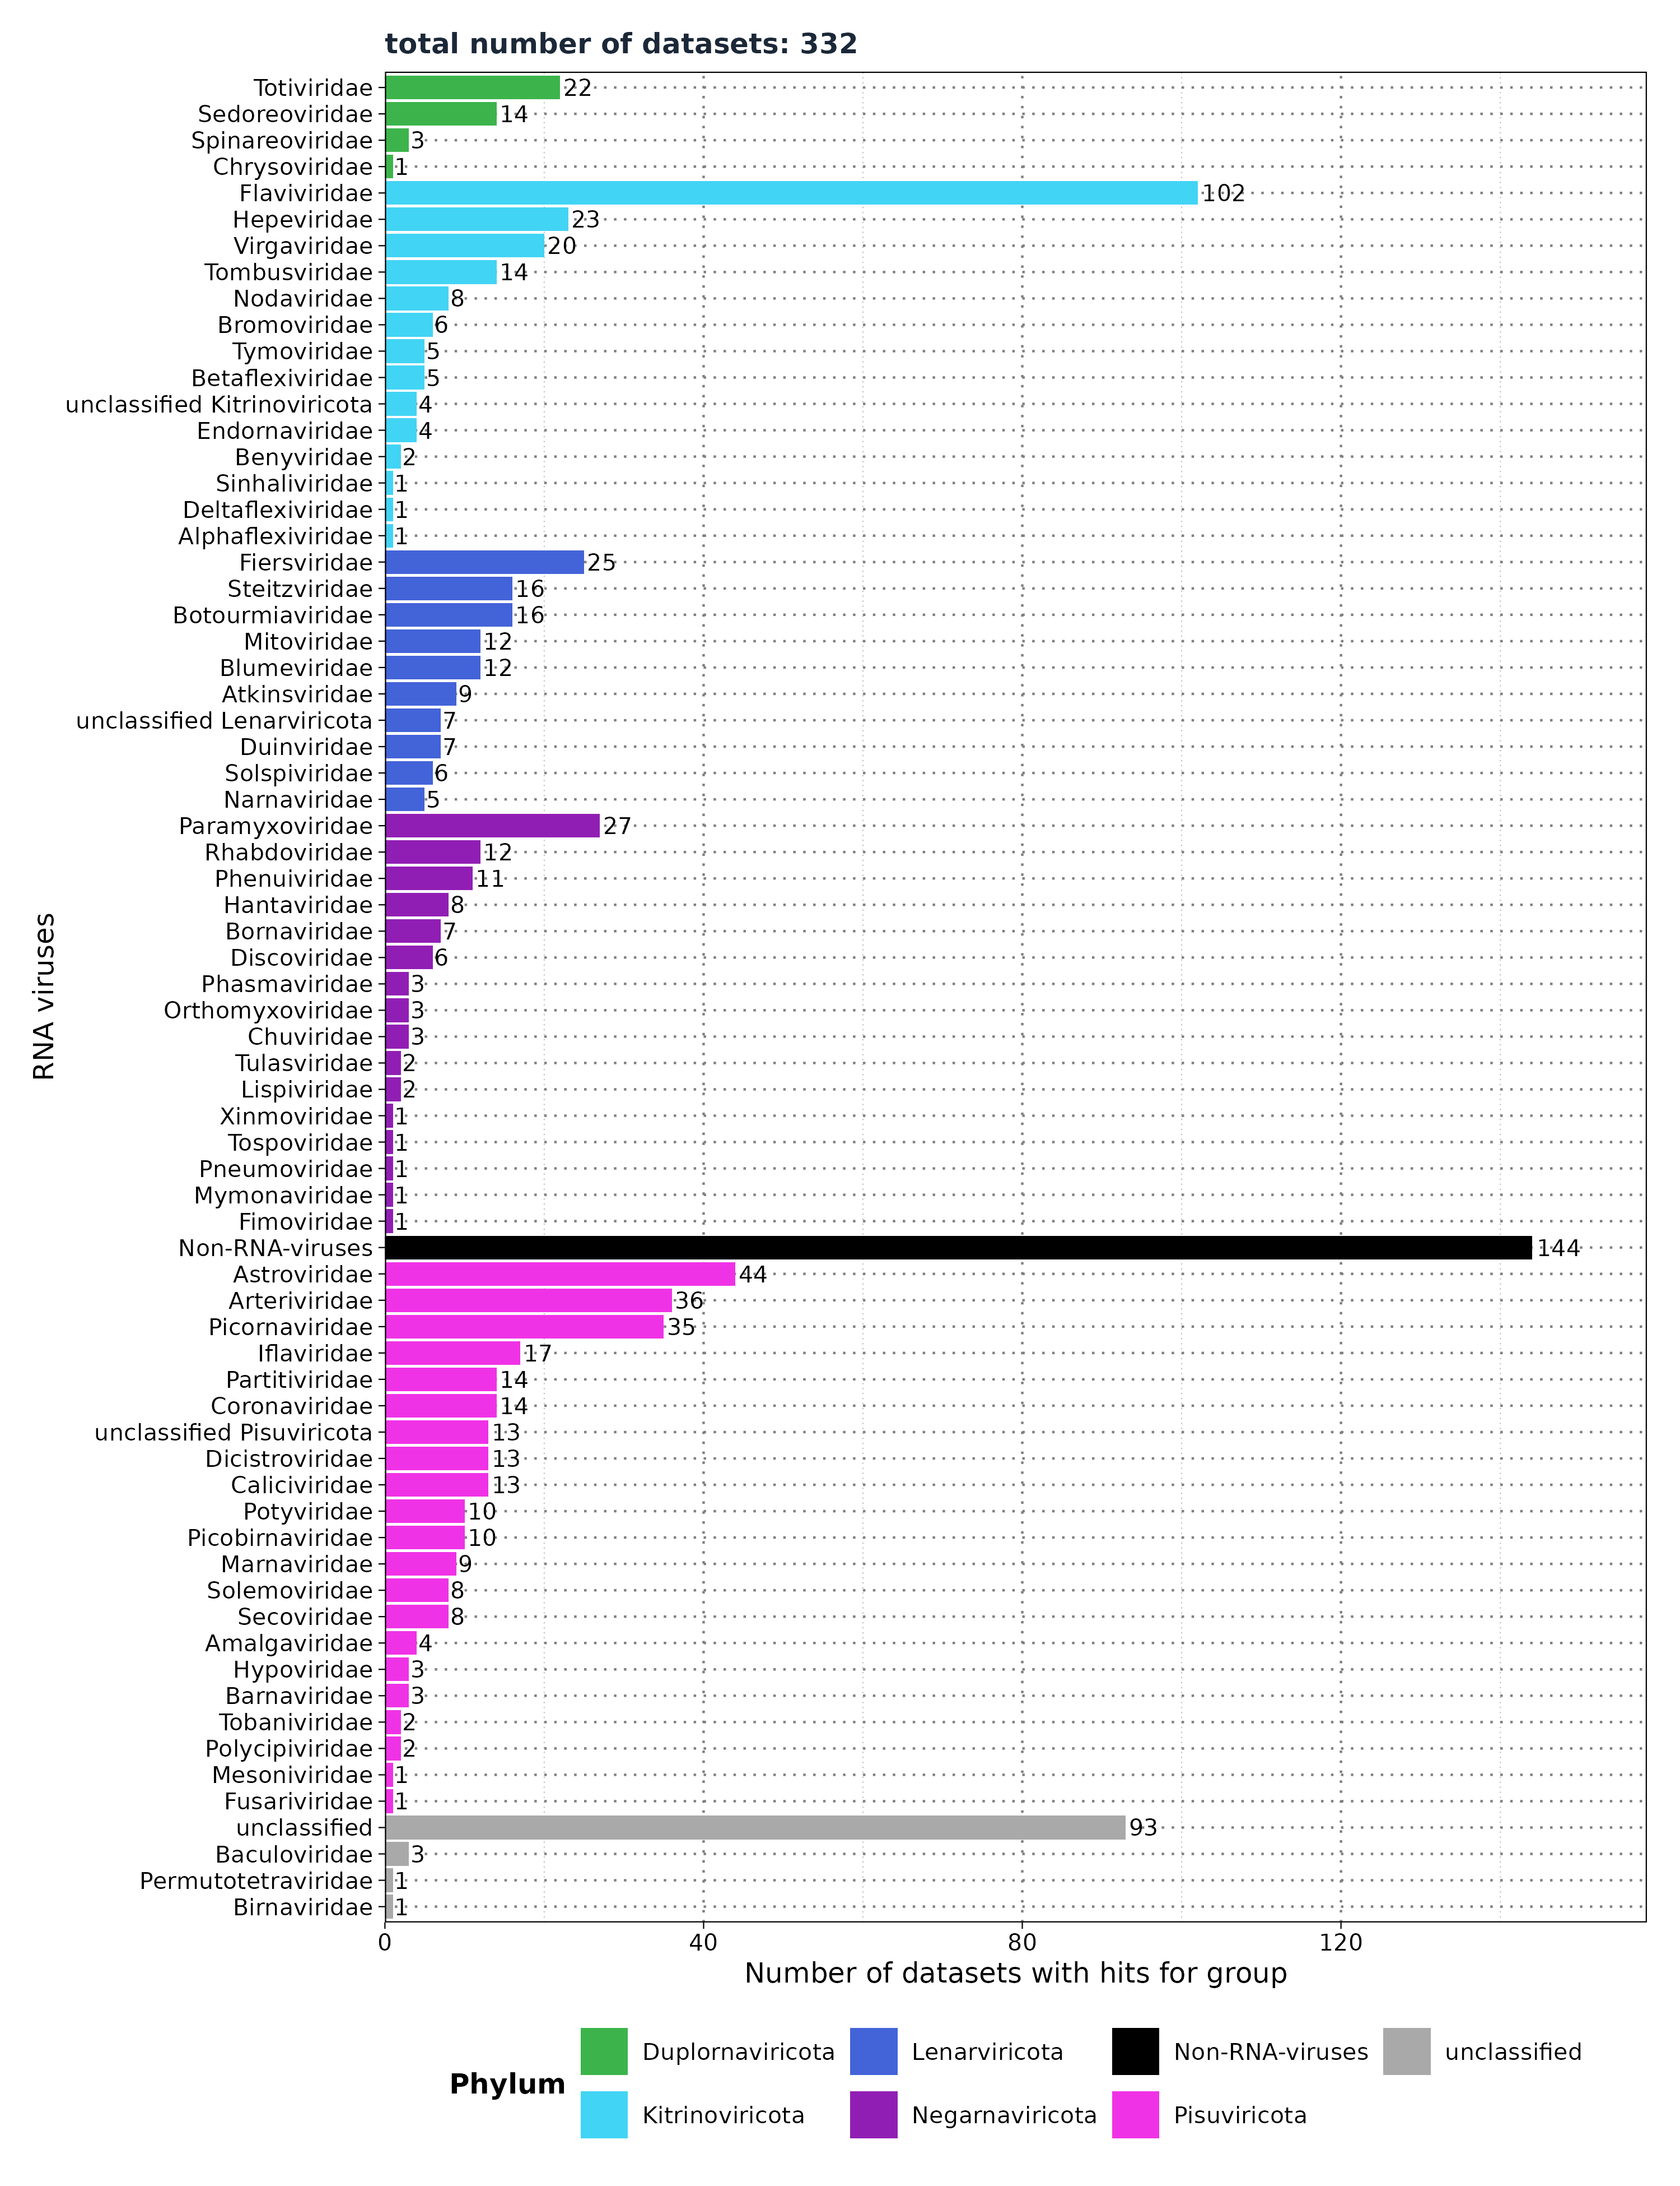
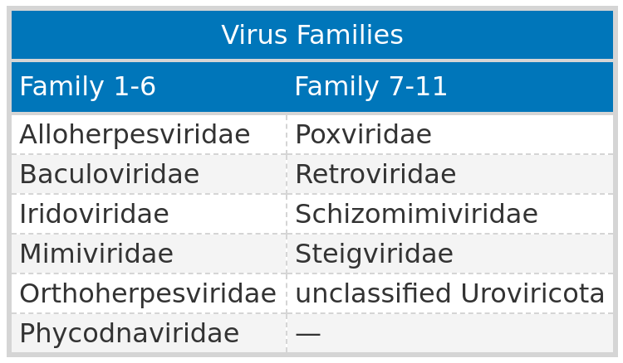
Results: Mammalian - Number of datasets with
viral hits
VirusGatherer
Filter ViralRefSeq_E < 1e⁻⁵
Viral Reference E-values
Non-RNA viruses: 0.37 (IQR: 7.41e⁻¹⁰ to 1.99)
RNA viruses: 1.34e⁻¹⁵ (IQR: 9.74e⁻³⁹ to 2.85e⁻⁷)

Slide 28
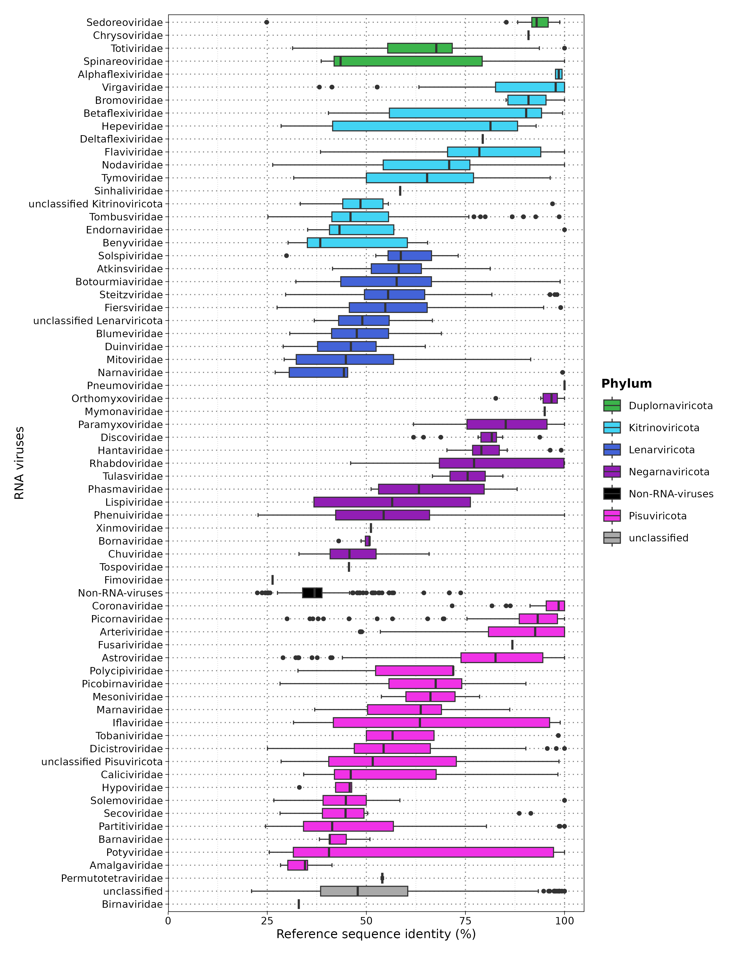
Results: Mammalian - Sequence identity
80.59% of viral contigs (5,004/6,209) had <90% protein sequence identity with the closest known virus.

Slide 29
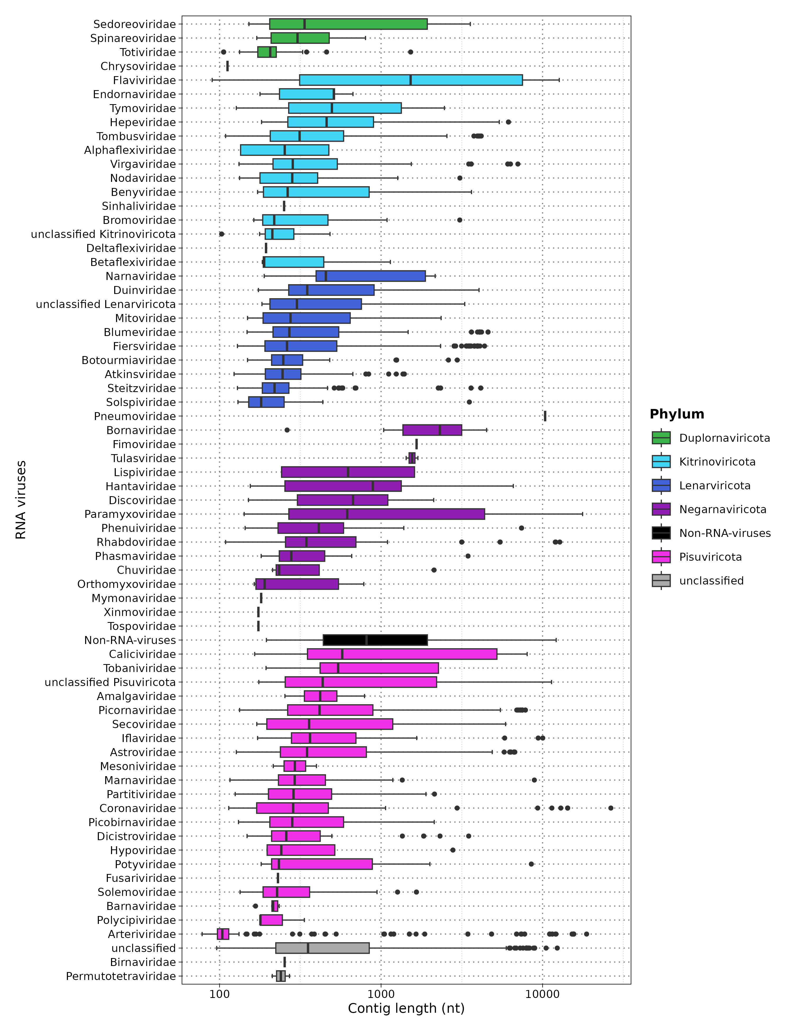
Results: Mammalian - Contig Length
Overall Summary:
Total Contigs: 1,225 contigs >1,000 nt.
Novel Contigs:
Total: 444 total >1,000 nt
Median Length: 2,619 nt (range: 1,001–26,479 nt)
Top 3 Phyla:
Pisuviricota:
Contigs: 258 (202 with <90% identity)
Key Families: Picobirnaviridae (46), Arteriviridae (36)
Kitrinoviricota:
Contigs: 148 (103 novel)
Key Families: Flaviviridae (58), Tombusviridae (28)
Lenarviricota:
Contigs: 97 (95 novel)
Key Families: Fiersviridae (41), Blumeviridae (14), Duinviridae (11)
Notes:
Cant present every phylum.

Slide 30
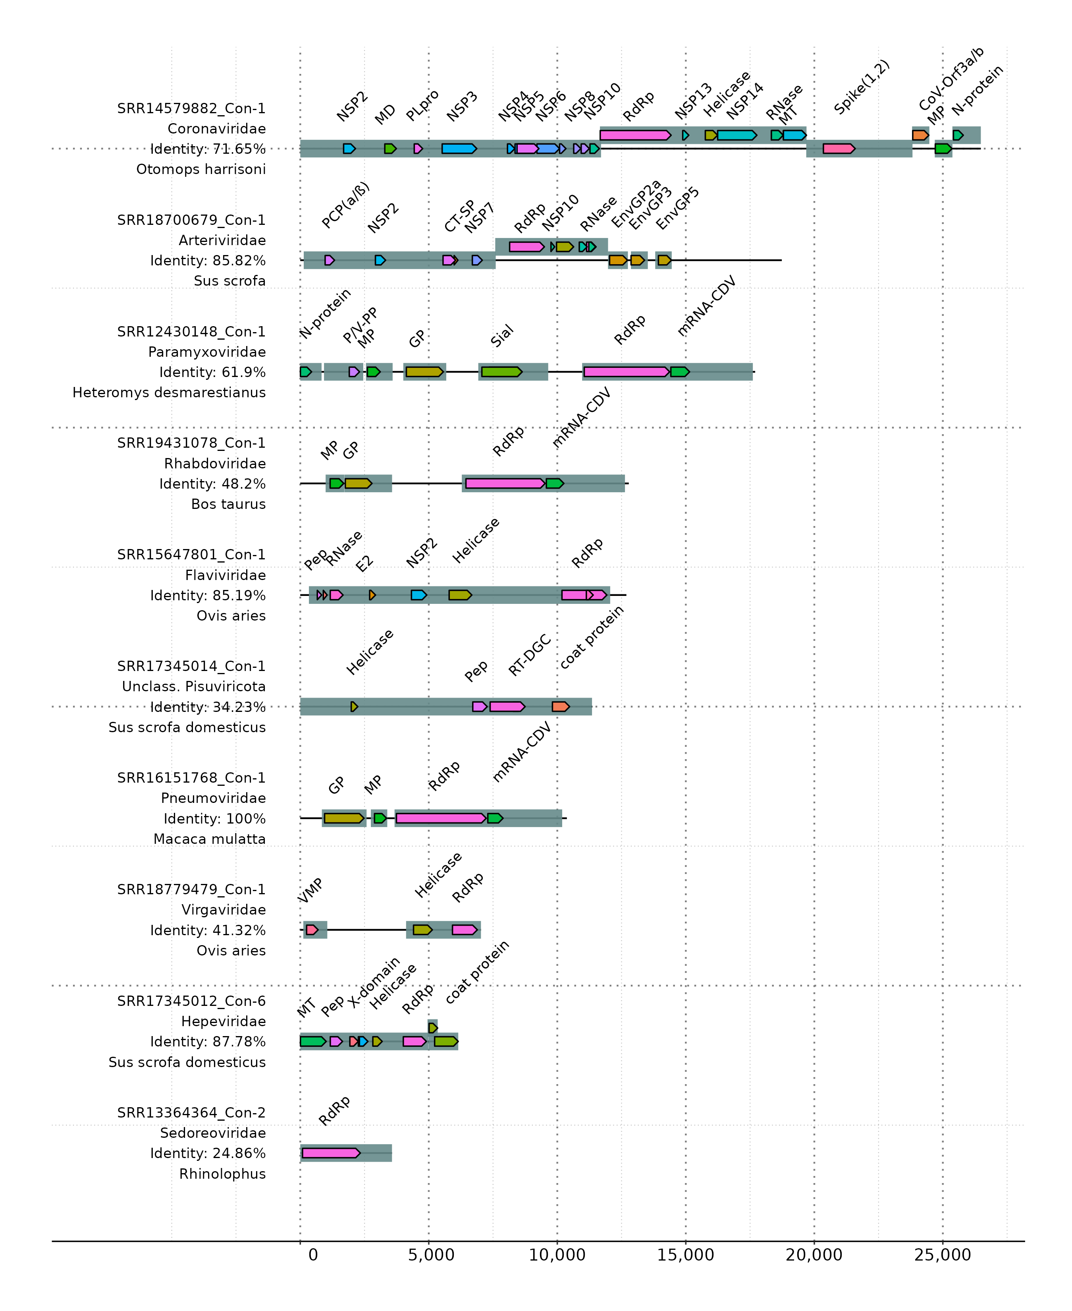
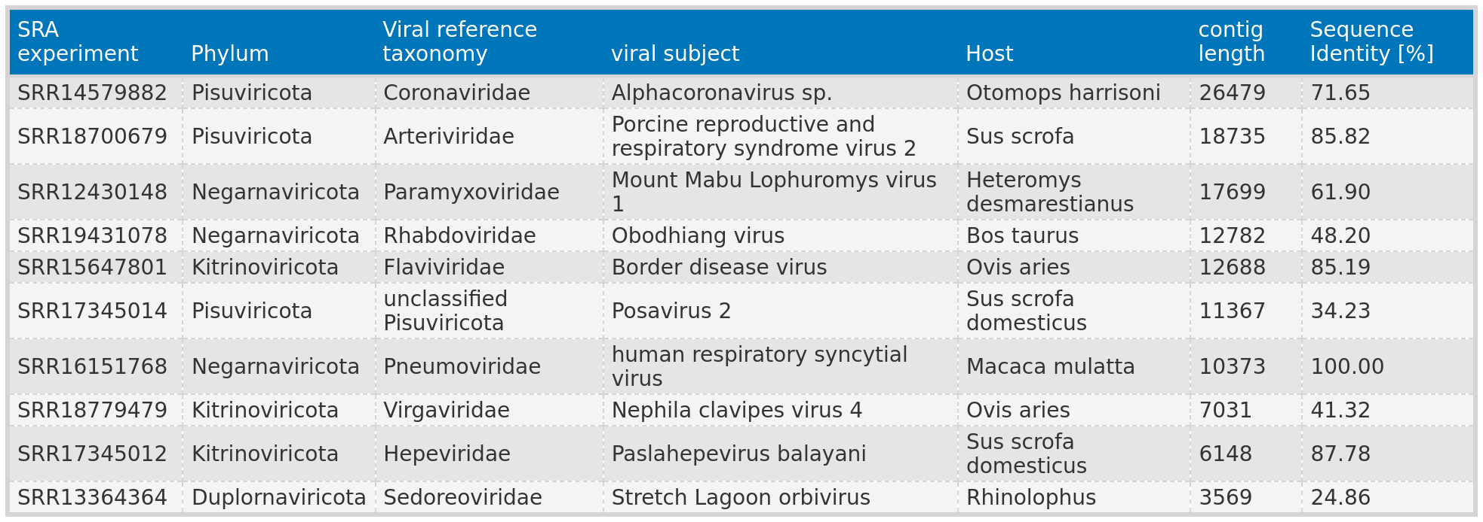
Results: Mammalian - Functional annotation
of the top ten largest contigs
SRR12430148_con-1: Identified RNA editing site (TTAAAAAAGGCA), similar to Mount Mabu Lophuromys virus 1¹.
Matches conserved motif (YTAAAARRGGCA) found in Henipavirus, Morbillivirus, and Jeilongvirus genera.
¹Vanmechelen B, Bletsa M, Laenen L, et al. Discovery and genome characterization of three new Jeilongviruses, a lineage of paramyxoviruses characterized by their unique membrane proteins. BMC Genomics. 2018;19(1):617. doi:10.1186/s12864-018-4995-0
Notes:
Interesting is the top virus → a novel alphacoronavirus.
Second longest virus is a redoscovery since the original paper also studied this virus.
Cell lines are valuable, since you can screen all cell lines for contaminants.

Slide 31
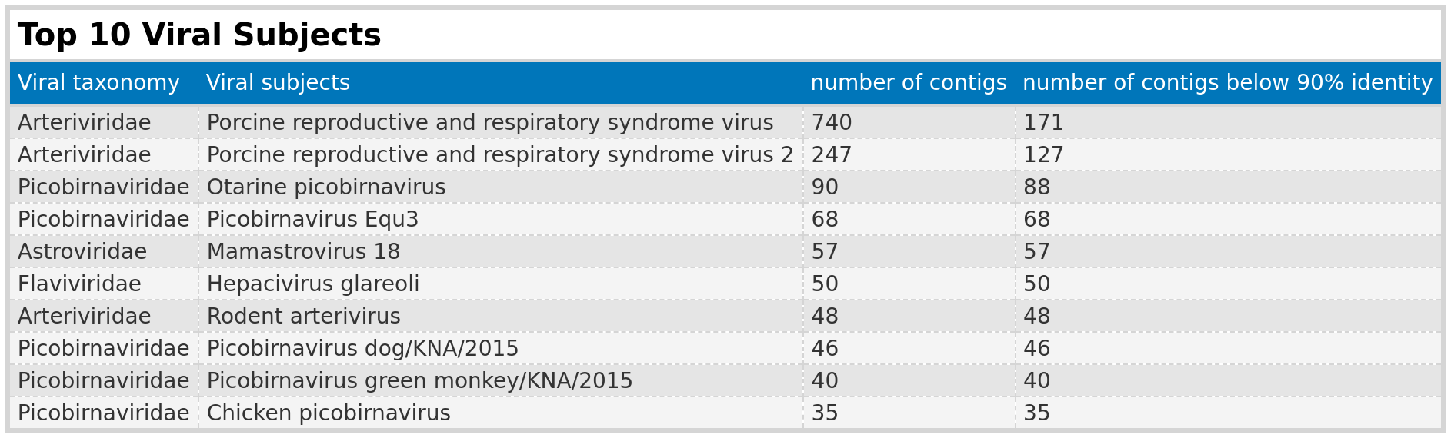
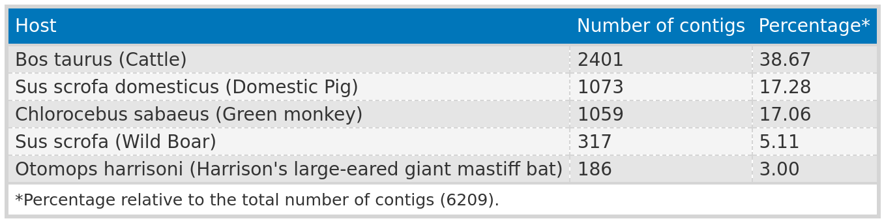
Results: Mammalian - Subjects
PRRSV: 981 contigs from study ERP130049, using African green monkey (Chlorocebus sabaeus) cell lines from fetal kidney tissue—not natural infections.
Otarine picobirnavirus: Typically found in sea lions, but detected in domesticated pigs.
Majority of hosts: Farm animals;
! dairy products but listing cattle (Bos taurus) as the host.
Notes:
Careful that 90% is not compeltly novel. It might be a different version of the virus.
Hypothesis: bovine meat and milk factors → when you drink milk or uncooked meat, you can find virus like elements – cause possible disease. No associations have been proven so far.
Nicht scientific name nutzen. Oder in ()

Slide 32
Results:Mammalian - Summary
RNA virus contig assembly results
Assembled 6,209 contigs from 332 samples aligned to RNA virus families.
Cross-finding: Identified 11 non-RNA virus families with lower E-values than RNA viruses.
Contig characteristics
80.59% (5,004/6,209) of viral contigs exhibited <90% protein sequence identity with the closest known virus.
19.72% (1,225) of contigs were >1,000 nt across all phyla.
444 contigs had a length >1,000 nt and sequence identity <90%.
Dominant phyla
Top three phyla: Lenarviricota, Kitrinoviricota, and Pisuviricota (most prevalent).
Predominantly associated with farm animal viruses.
Functional annotation
Consistent identification of RNA-dependent RNA polymerase (RdRp), used for screening.
Many contigs revealed characteristic protein domains specific to their virus families, including an RNA editing site.
Notable findings
Detected Otarine Picobirnavirus and viruses present in dairy products and fetal kidney cell lines from African green monkeys.
Notes:
Flaviviridae > Appears in most datasets with low identity and large contig lengths
>Arteviridae with the most observations in the dataset, extreme differences in contig length and most subjects found.
> Picobirnaviridae → 99 % of identity below 90 % and contributing 50 % of subjects in top 10.

Slide 33
Conclusion and Outlook

Slide 34
Conclusion
Taubert – liver sequencing data:
Analysis complete with only up to 6 files returning assembled contigs.
E-values near cutoff, and short contig lengths.
No conclusive evidence links viral infections to liver rejection.
Mammalian sequencing data:
6,209 contigs from 332 samples → 80.59% (5,004) exhibited <90% protein sequence identity → 19.72% (1,225) were >1,000 nt → 444 contigs had a length >1,000 nt and sequence identity <90%.
Cross findings: 11 Non-RNA viruses.
characteristic protein domains specific to their virus families.
known virus families associated with farm animals.
Limitation of utilizing SRA host information: viruses in cultivated cells or host by-products.
Virusparies:
R package designed to enable users to visualize, process, and summarize the hittable outputs from VirusHunterGatherer.
Tool for visualizing or summarizing results → Reports.
Each function is highly modular, allowing users to customize the output of Virusparies functions to their preferences.
Accessible to a larger audience, especially for wet-lab scientists with rudimentary R knowledge.
Virusparies enhances code reusability.

Slide 35
Outlook
Curation:
Eliminate unwanted contigs (non-host entries).
tracing the samples back to the original work to determine the virus's source, the data processing methods used, and any relevant information about the virus or host.
Phylogenetic analysis:
Transition from basic taxonomic annotations to detailed classification.
Verify if novel viruses have new proteins.
Distinguish genuine sequences from contaminants.
Contigs from mammalian sequencing data as future resource:
Contigs could potentially serve as a valuable resource for the Computaional Virology Research Groups current and future projects.
Li Chuin Chong's research on predicting the spillover risk of RNA viruses could benefit from these newly assembled contigs.
Notes:
Stress the last point. I assembled contigs because they might help existing and future projects.

Slide 36
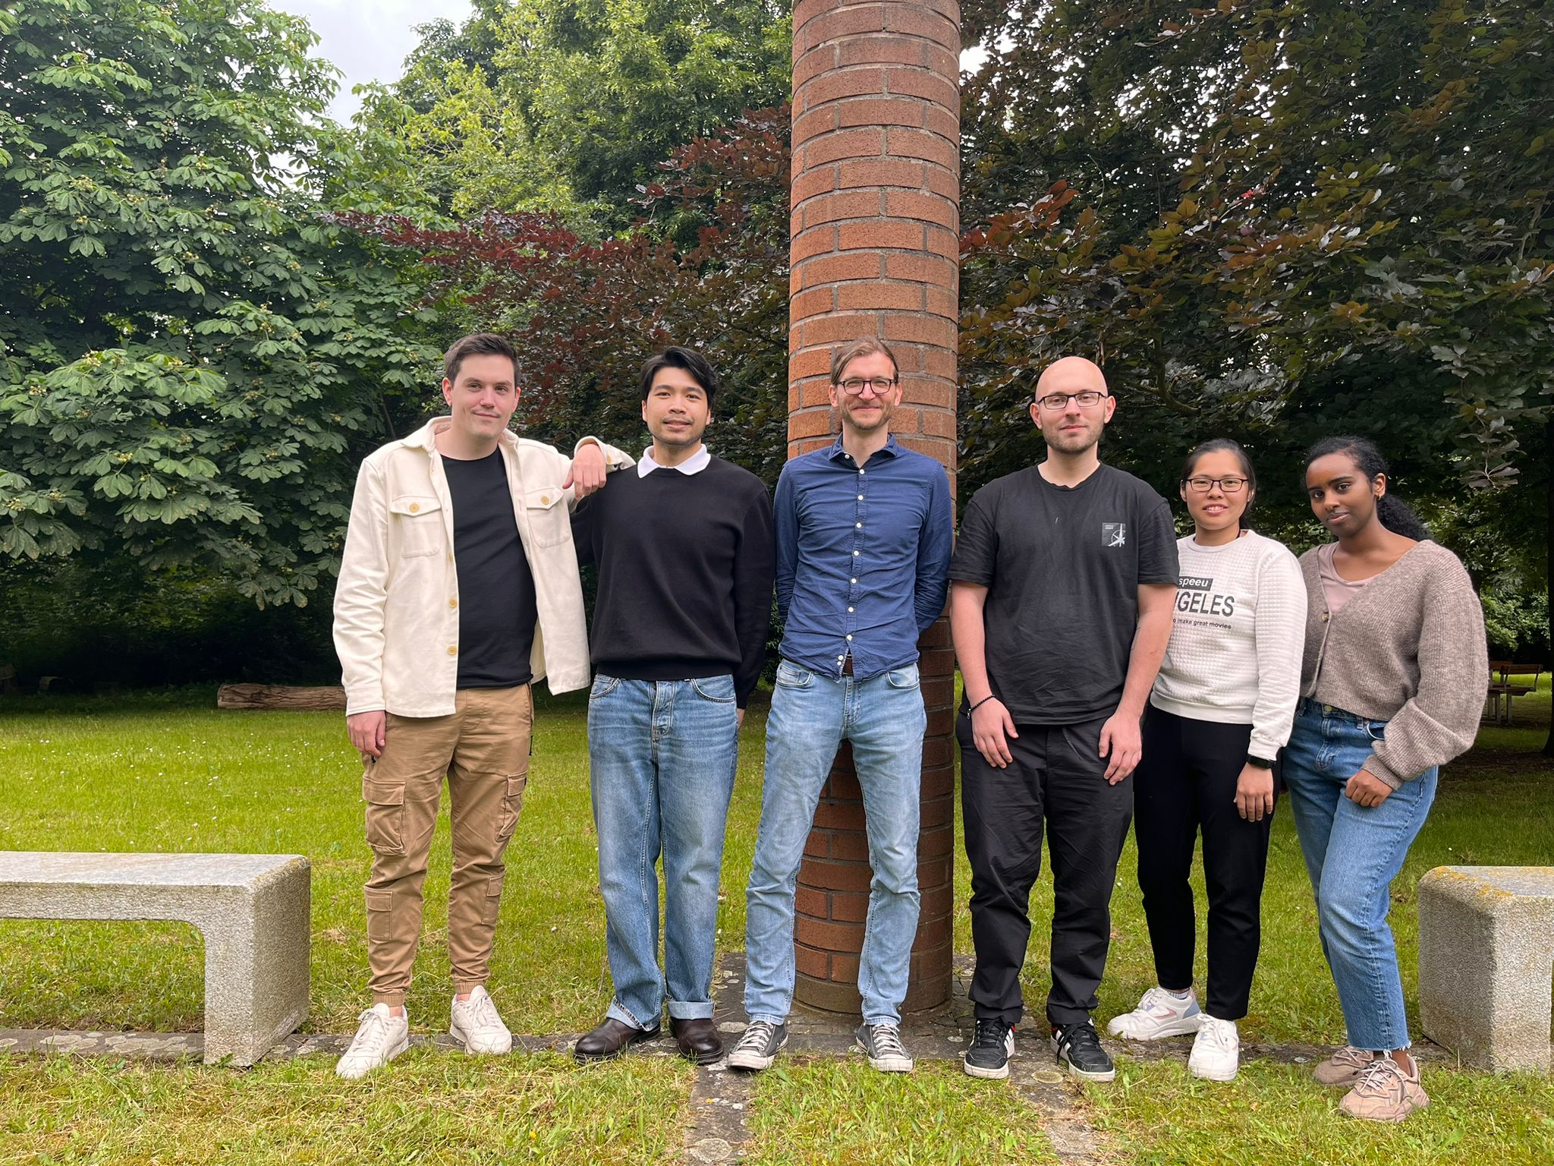
Acknowledgement
First supervisor:
Prof. Dr. Chris Lauber.
Second supervisor:
Prof. Dr. Helena U. Zacharias.
Li Chuin Chong.
Taubert – Department of Gastroenterology,Hepatology, Infectious Diseases and Endocrinology.
Computational Virology Research Group.
Institute for Experimental Virology.
Scientific community.

Slide 37
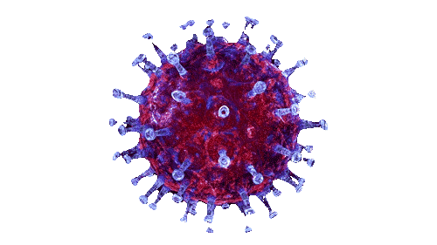
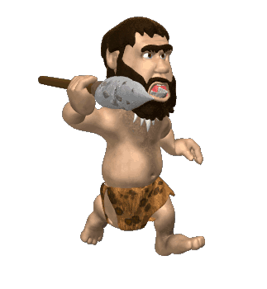
Thank you for listening! Any questions?

Slide 38
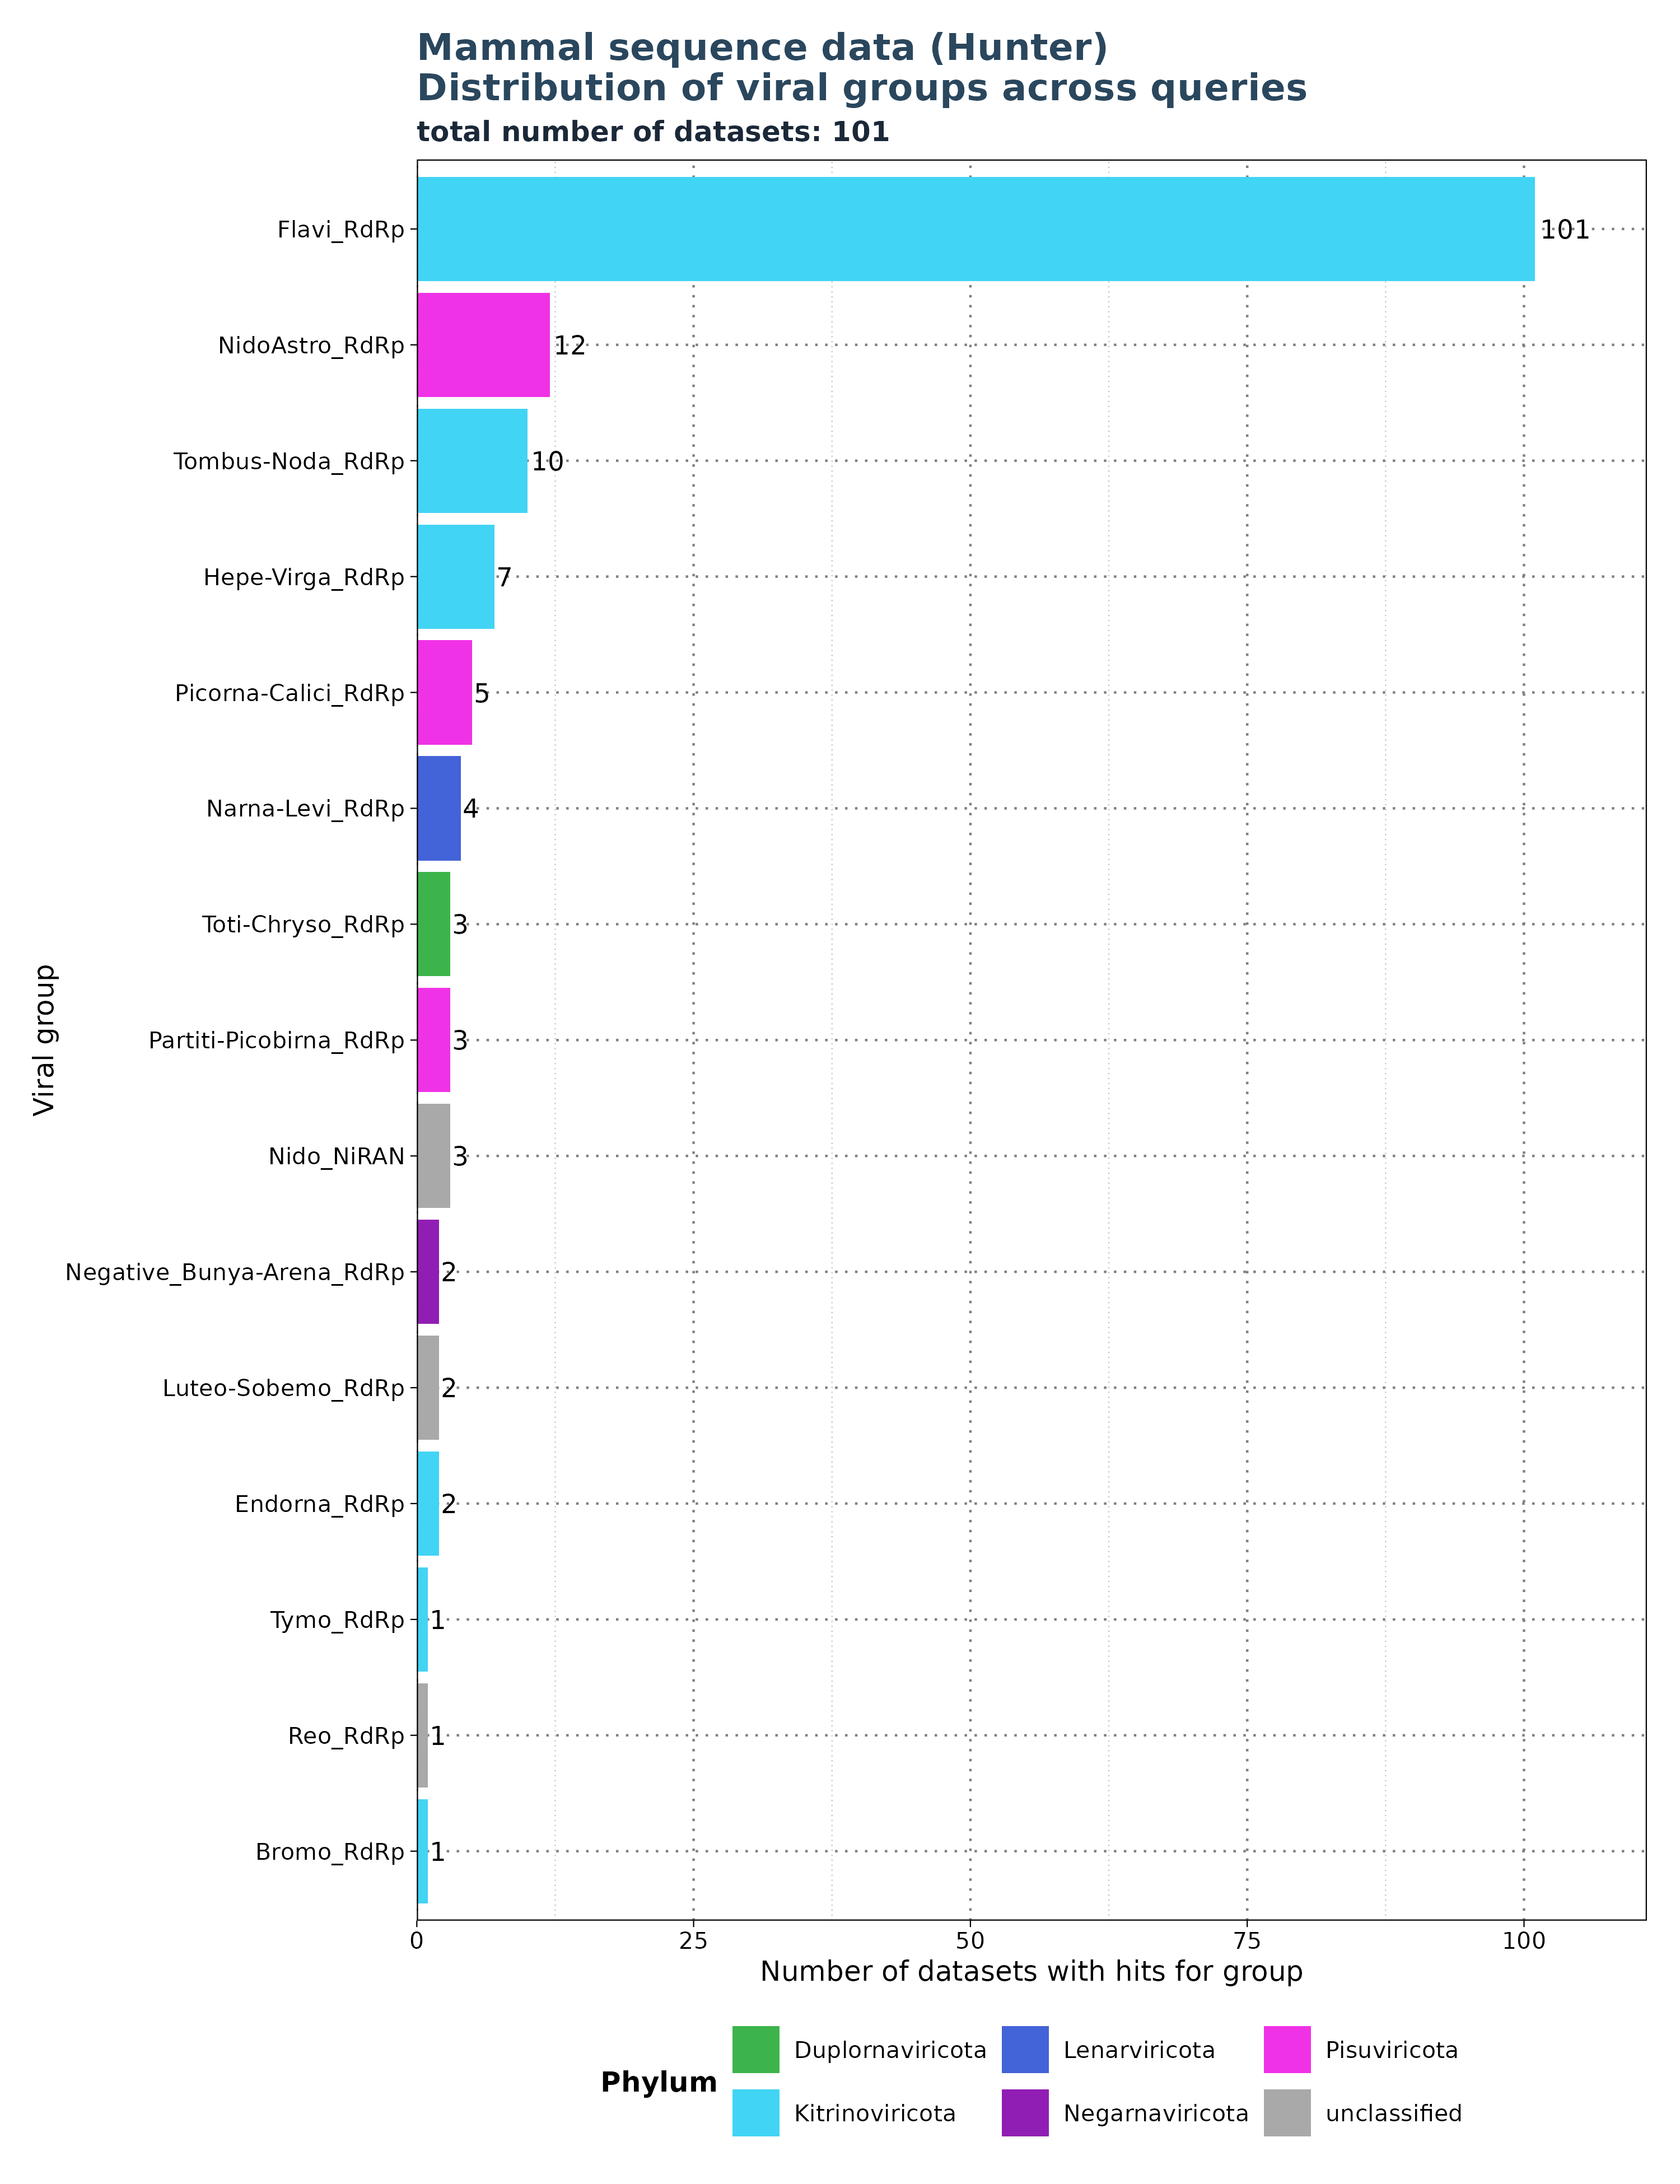
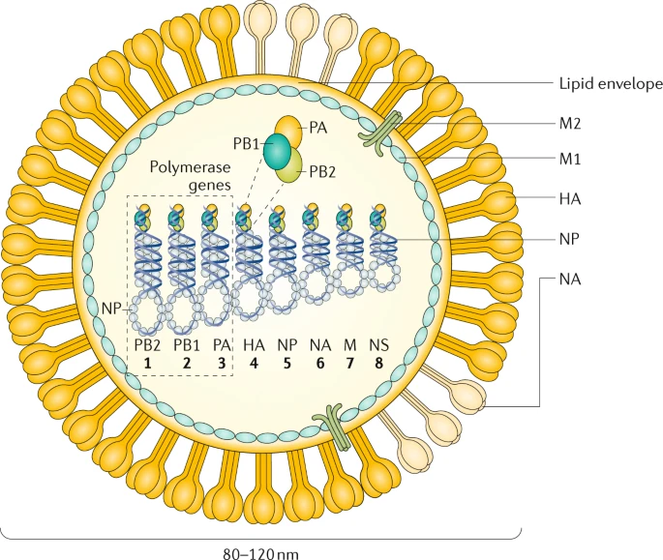
Limitations: Segmented viruses and specificity of profiles
Krammer, F., Smith, G.J.D., Fouchier, R.A.M. et al. Influenza. Nat Rev Dis Primers 4, 3 (2018). https://doi.org/10.1038/s41572-018-0002-y
Search for: Flavi_RdRp.

Slide 39
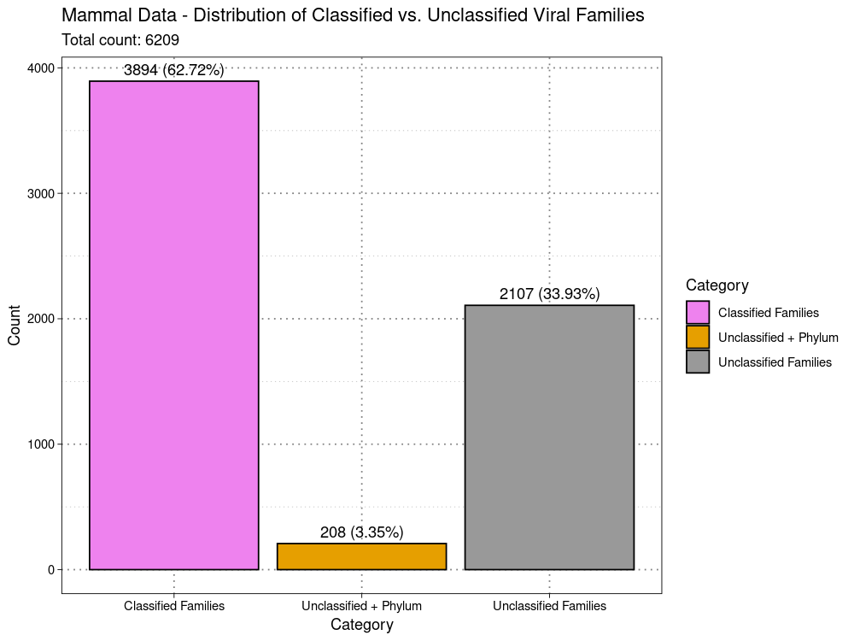
Limitations:
classified vs unclassified
Viral Family extracted from
ViralRefSeq_taxonomy column
ViralRefSeq_taxonomy:
taxid:1354498|Hepacivirus
colobi|Hepacivirus|Flaviviridae|Amarillovirales|Flasuviricetes|Kitrinoviricota|Orthorn
avirae|Riboviria

Slide 40
Extrapolated viral diversity estimates from a bat and primate species to assess emerging human threats.
These represent the only published estimates of unknown viral diversity in vertebrate hosts.
99% of viral zoonoses originate from non-human mammals or in birds → 69 mammal and 8 bird out of 78.
Viruses that originate in or have that originate in those hosts
Estimates of viral diversity for the bat Pteropus giganteus are based
on repeated sampling of individuals of this species and viral discovery using PCR with degenerate family-level primers targeting 9 viral genera or families, all known to contain zoonoses.
Estimates of viral diversity for the rhesus macaque Macaca mulatta targeted 21 viral families by PCR, as well as high-throughput sequencing (HTS).
Average of 11.58 viruses/family (SE: 6.74),indicating that the average viral family has between 4.84 and 18.32 viral species (skewed by Picobirnoviruses).
Median is 2.5 species/family.
For the Global Virome Project (GVP), 25 viral families with high zoonotic potential were targeted, estimating a global mammalian viral richness of 1.53 million species (SE: 640k-2.42M). Additionally, avian influenza viral richness was estimated at 137k species, leading to a total global estimate of 1.67 million viral species from zoonotic families.

Slide 41
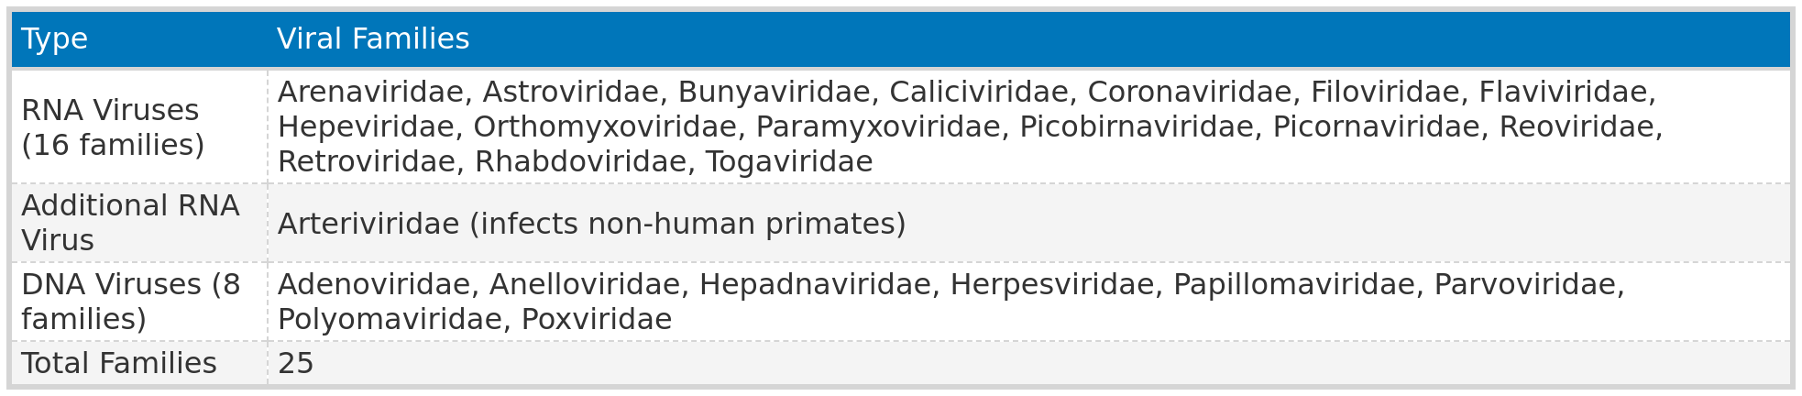
25 families * 11.58 species/family * 5,291 (number of mammalian species) = 1.5 mil
Orthomyxoviridae (Influenza) * 11.58 * 11,862 = 137,362.96

Slide 42
“We therefore multiply the per-viral family mean of 11.58 species by 25 (see specific viral families listed below) to give an estimate of the total viral diversity within all 25 viral families that have high zoonotic potential as 289.5 (se 121.0 - 458.0) for each mammalian host species. Given that there
are 5,291 known mammal species (21) (excluding marine mammals which have limited
contact with humans relative to terrestrial and volant mammals) we estimate global
mammalian viral richness in our 25 target viral families at 1,531,745 (se 640,211 -
2,423,278). In addition, influenza viruses derived from mammals and birds represent a
significant public health threat globally. Therefore, we used the mean viral diversity per
viral family in mammal hosts (11.58), and assumed that this may also represent the
average per-host species viral diversity for influenza viruses (Orthomyxoviridae) in each
of the 11,862 known bird species bird species (22). This gives an estimated avian
influenza viral richness of 137,362.96 (se 57,412 - 217,312), and a total global richness
of viral species from families with high zoonotic potential of around 1,669,106.”

